Slide 1


Cosmology with SPT-3G
Cail Daley
CosmoStat, CEA Paris-Saclay
Séminaire postdoc du DAp March 11, 2025

Slide 2


Outline
Cosmology with the Cosmic Microwave Background (CMB) The South Pole Telescope (SPT) and the SPT-3G camera Recent and upcoming 2019+2020 SPT-3G results
Cross-correlations with Euclid

Slide 3
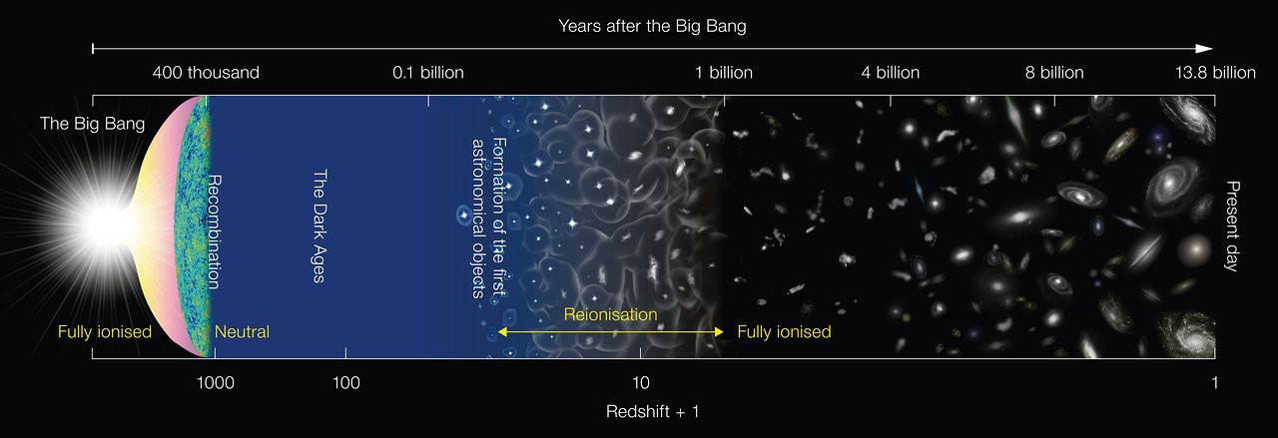
Cosmology with the CMB
most distant observable electromagnetic radiation early-Universe physics illuminates the Universe’s evolution: reionization, structure growth, astrophysics..
NAOJ

Slide 4
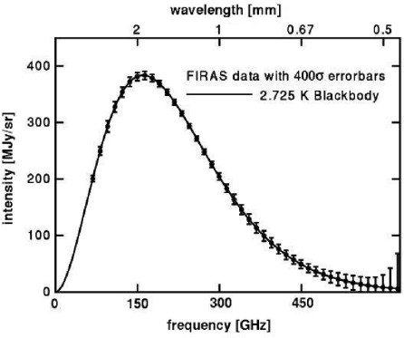
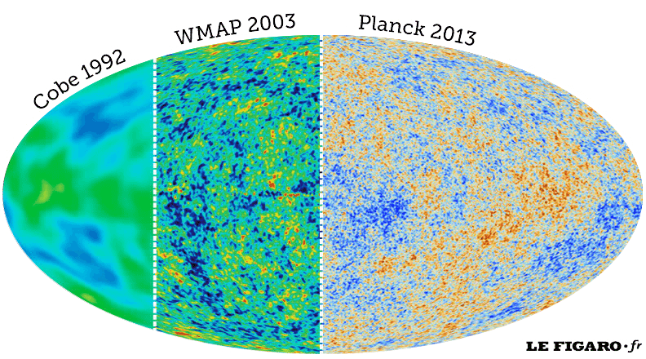
Cosmology with the CMB
Turner (2022): The Road to Precision Cosmology

Slide 5
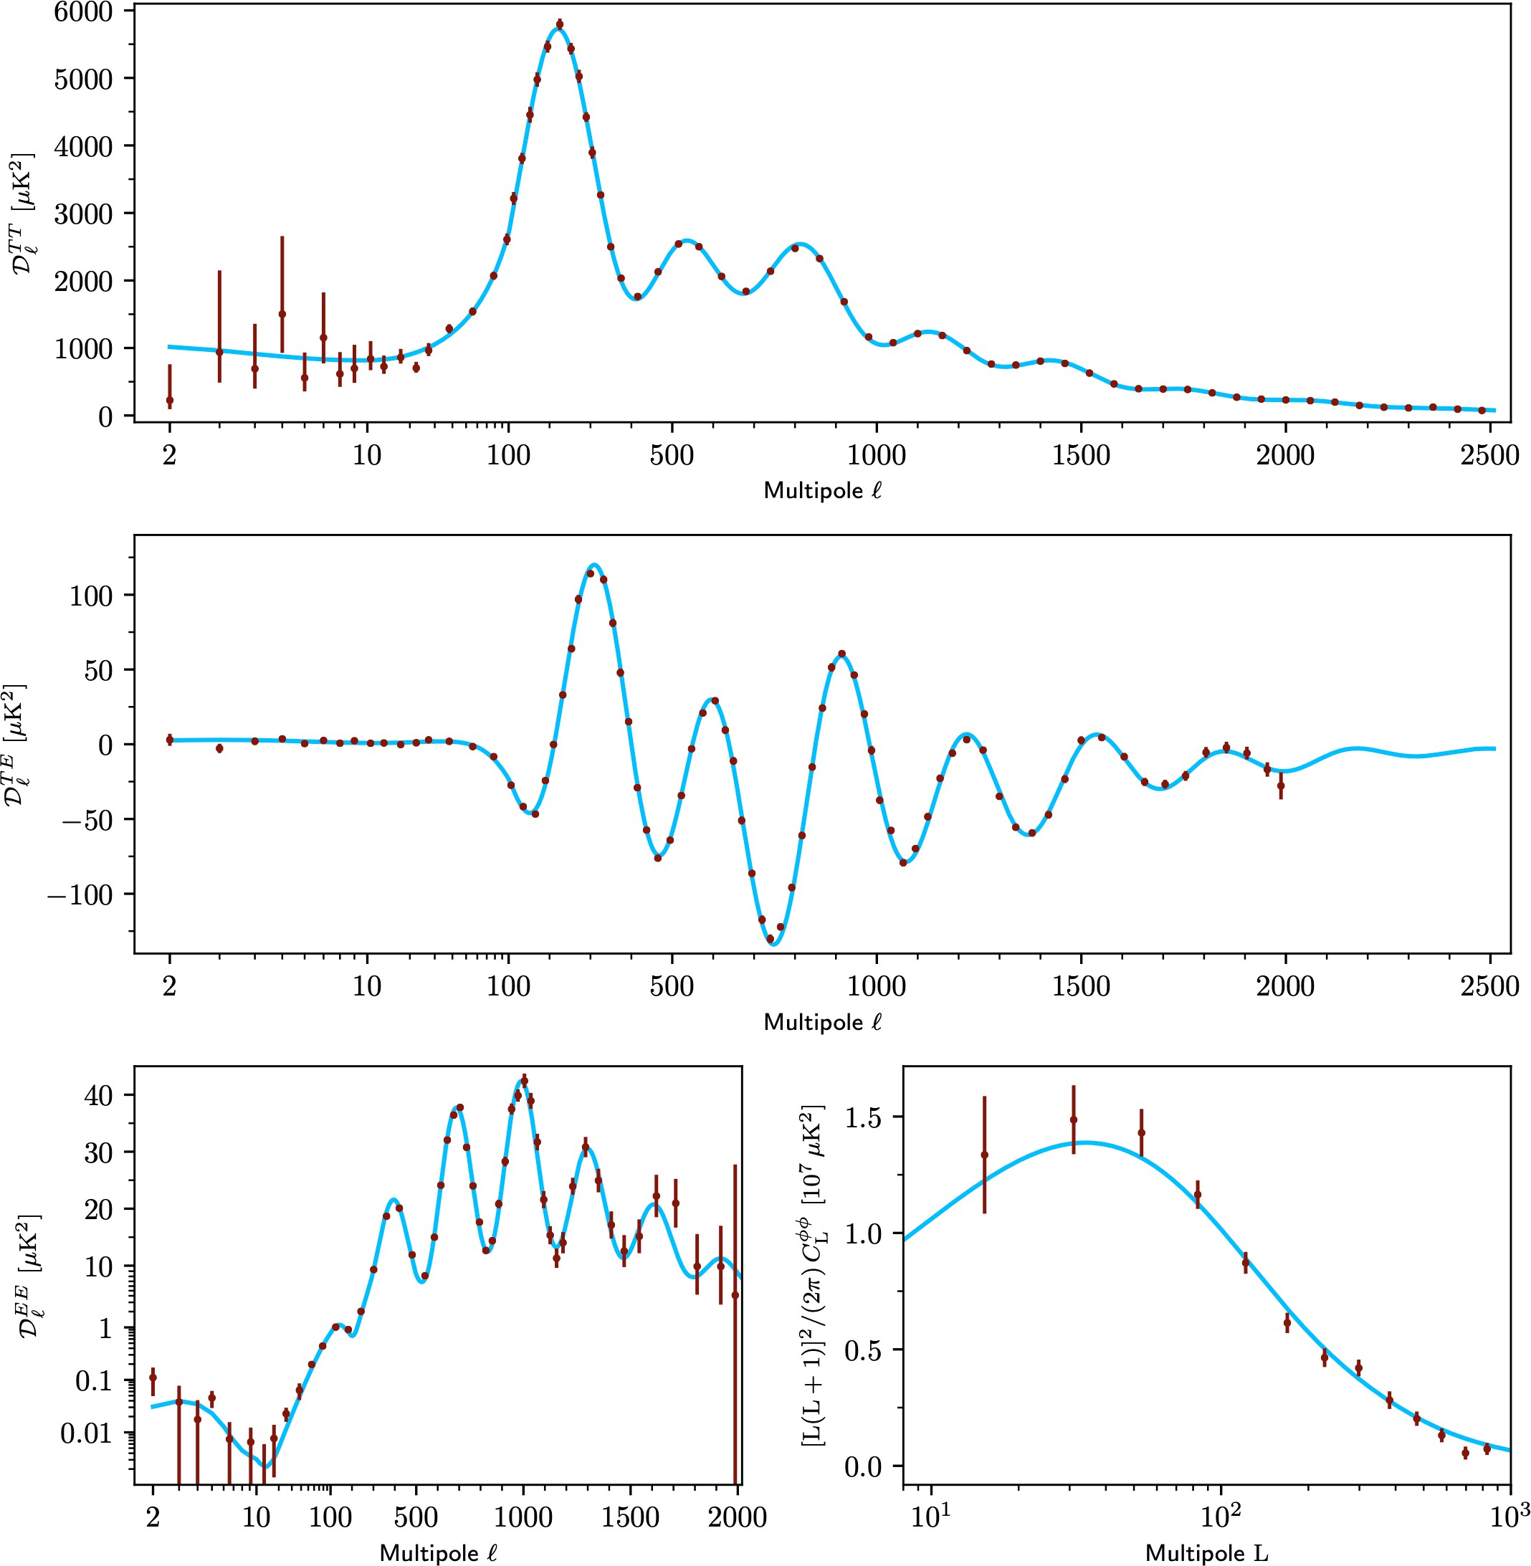
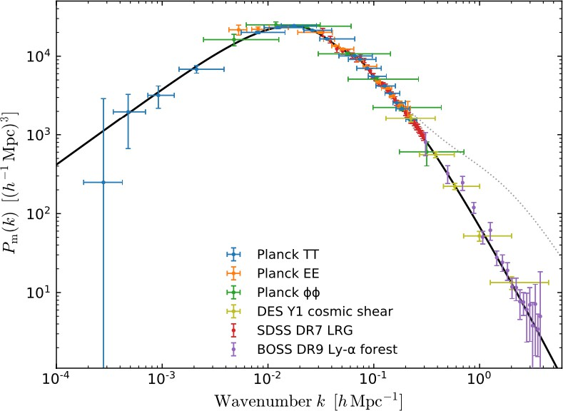
CDM Concordance
six-parameter model predicts a wide range of cosmic observables:
Planck Collaboration (2018)

Slide 6
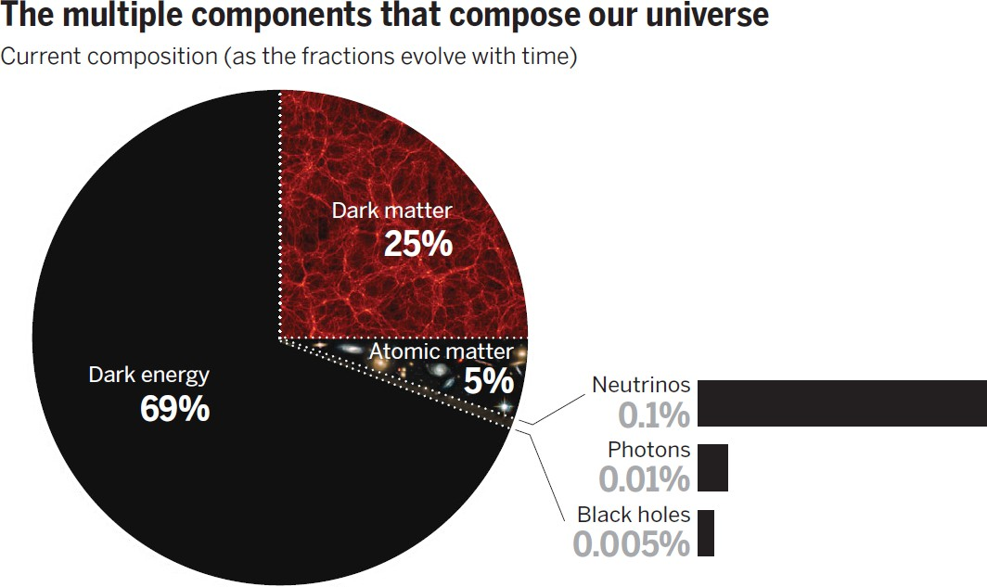
CDM Phenomenology
David Spergel / AAAS / Science

Slide 7
CDM Phenomenology
but we don’t much about
or CDM!
David Spergel / AAAS / Science
6.1

Slide 8


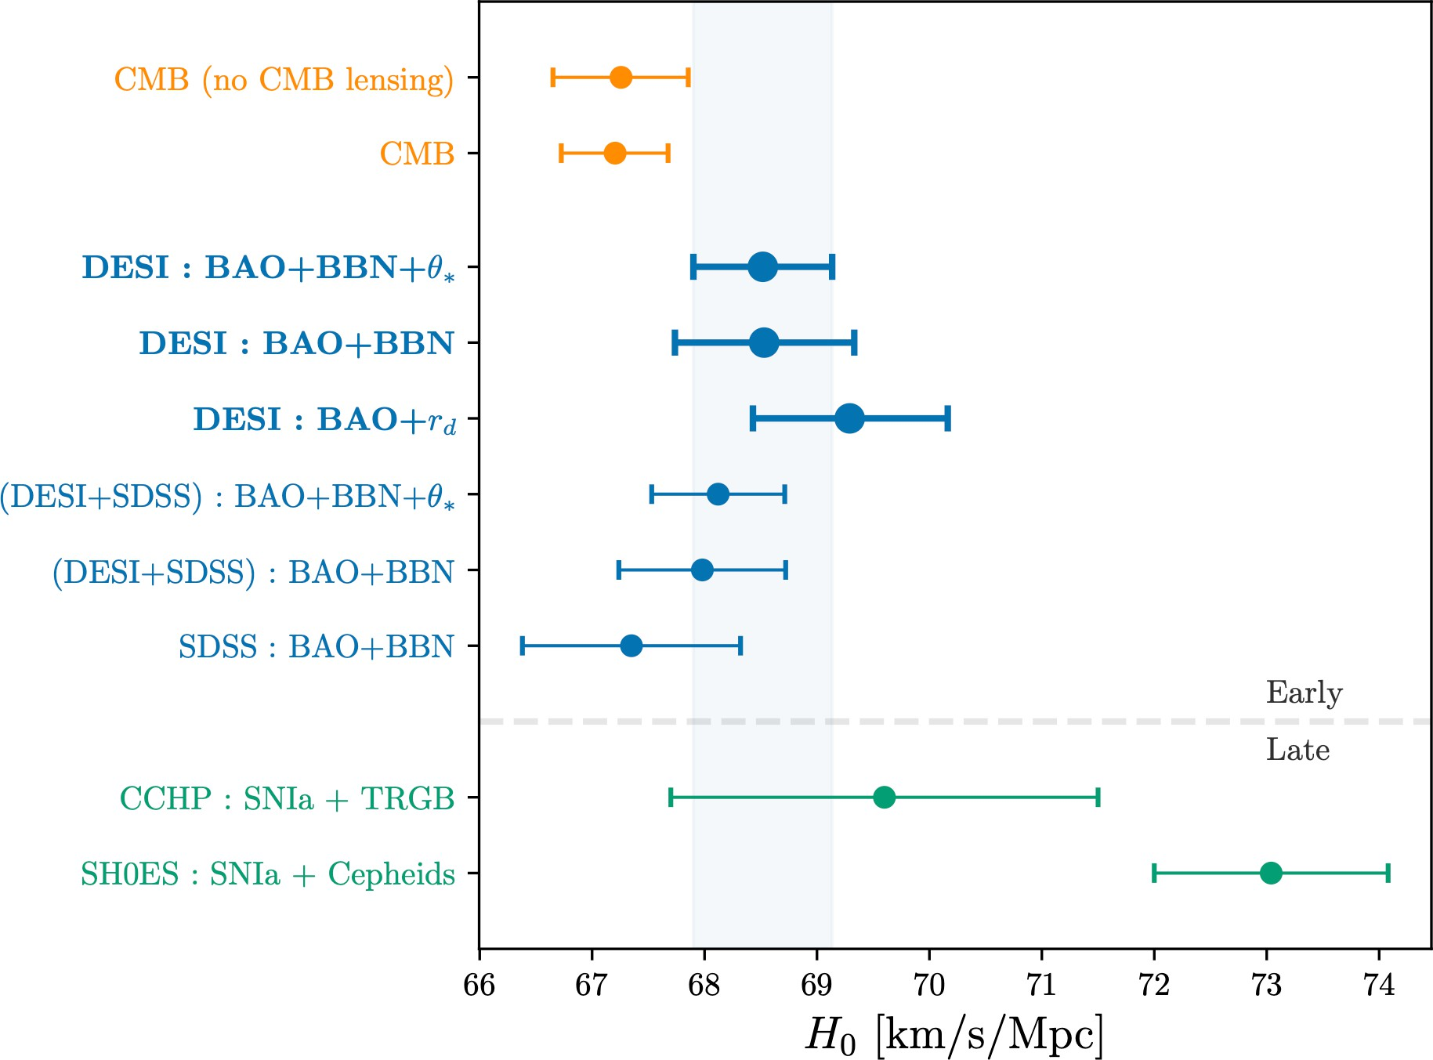
CDM Cracks
Tensions between early- and late-time measurements of
DESI Collaboration (2024)
7

Slide 9
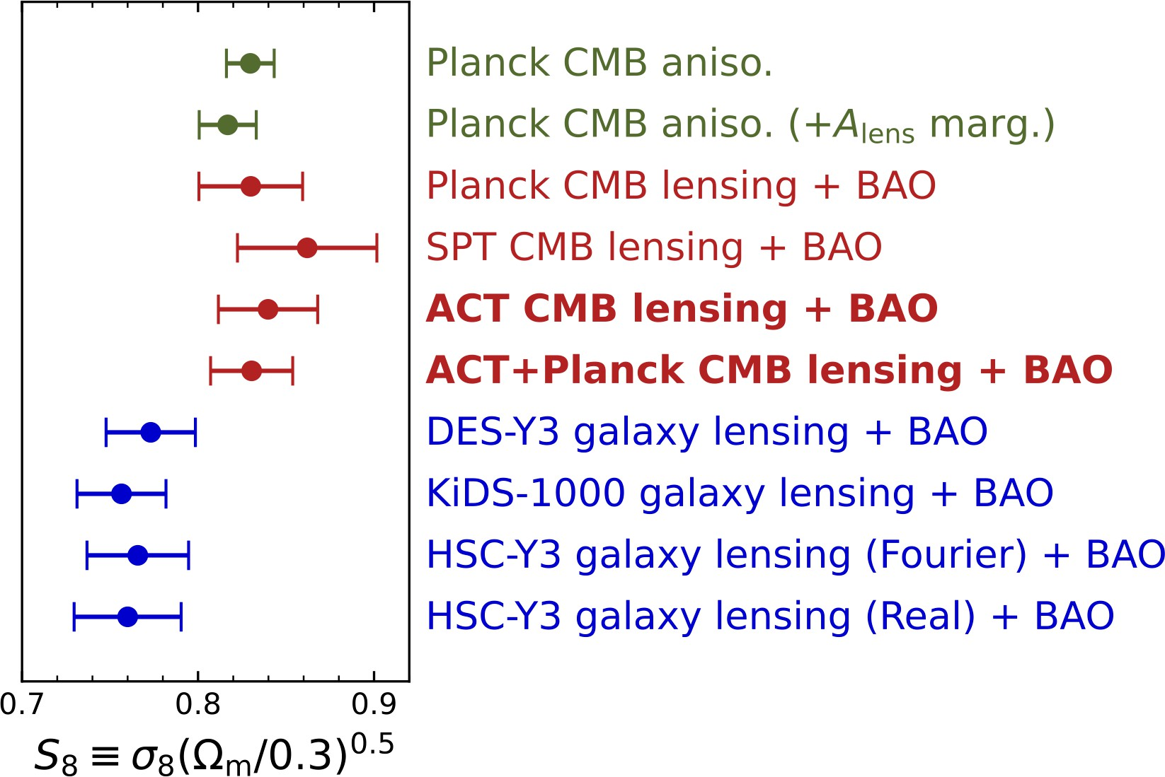


CDM Cracks
Tensions between early- and late-time measurements of and :
Madhavacheril et al. (2023)
DESI Collaboration (2024)

Slide 10



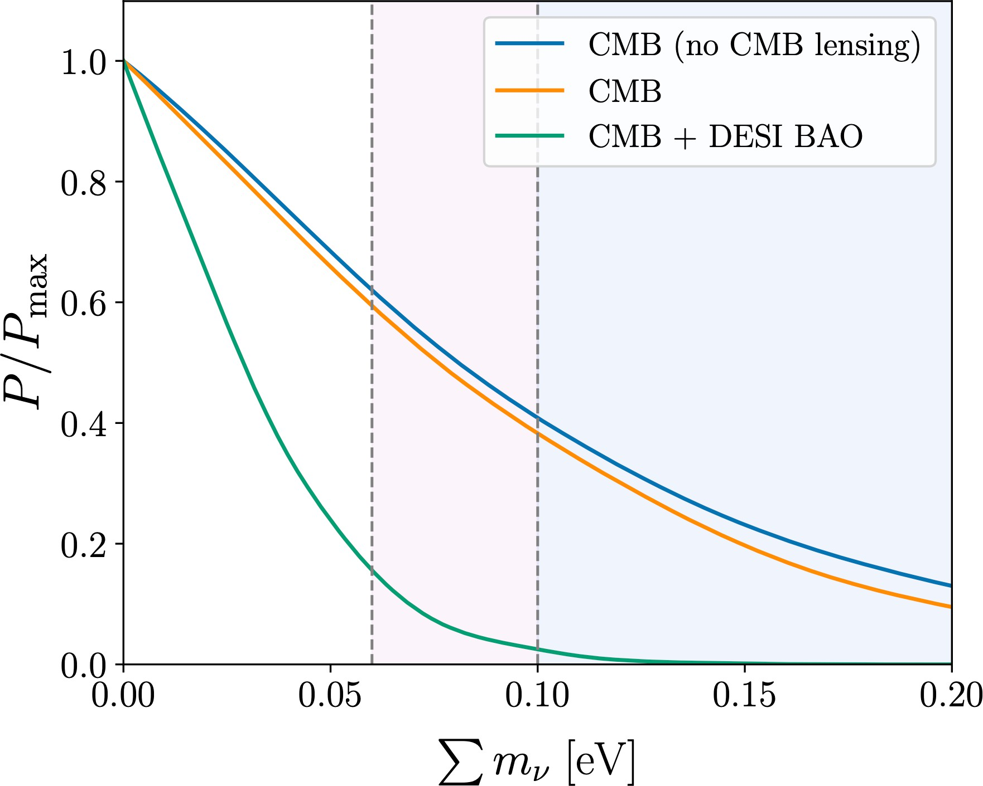
CDM Cracks
Tensions between early- and late-time measurements of and :
Low neutrino masses?
Madhavacheril et al. (2023)
DESI Collaboration (2024
)

Slide 11
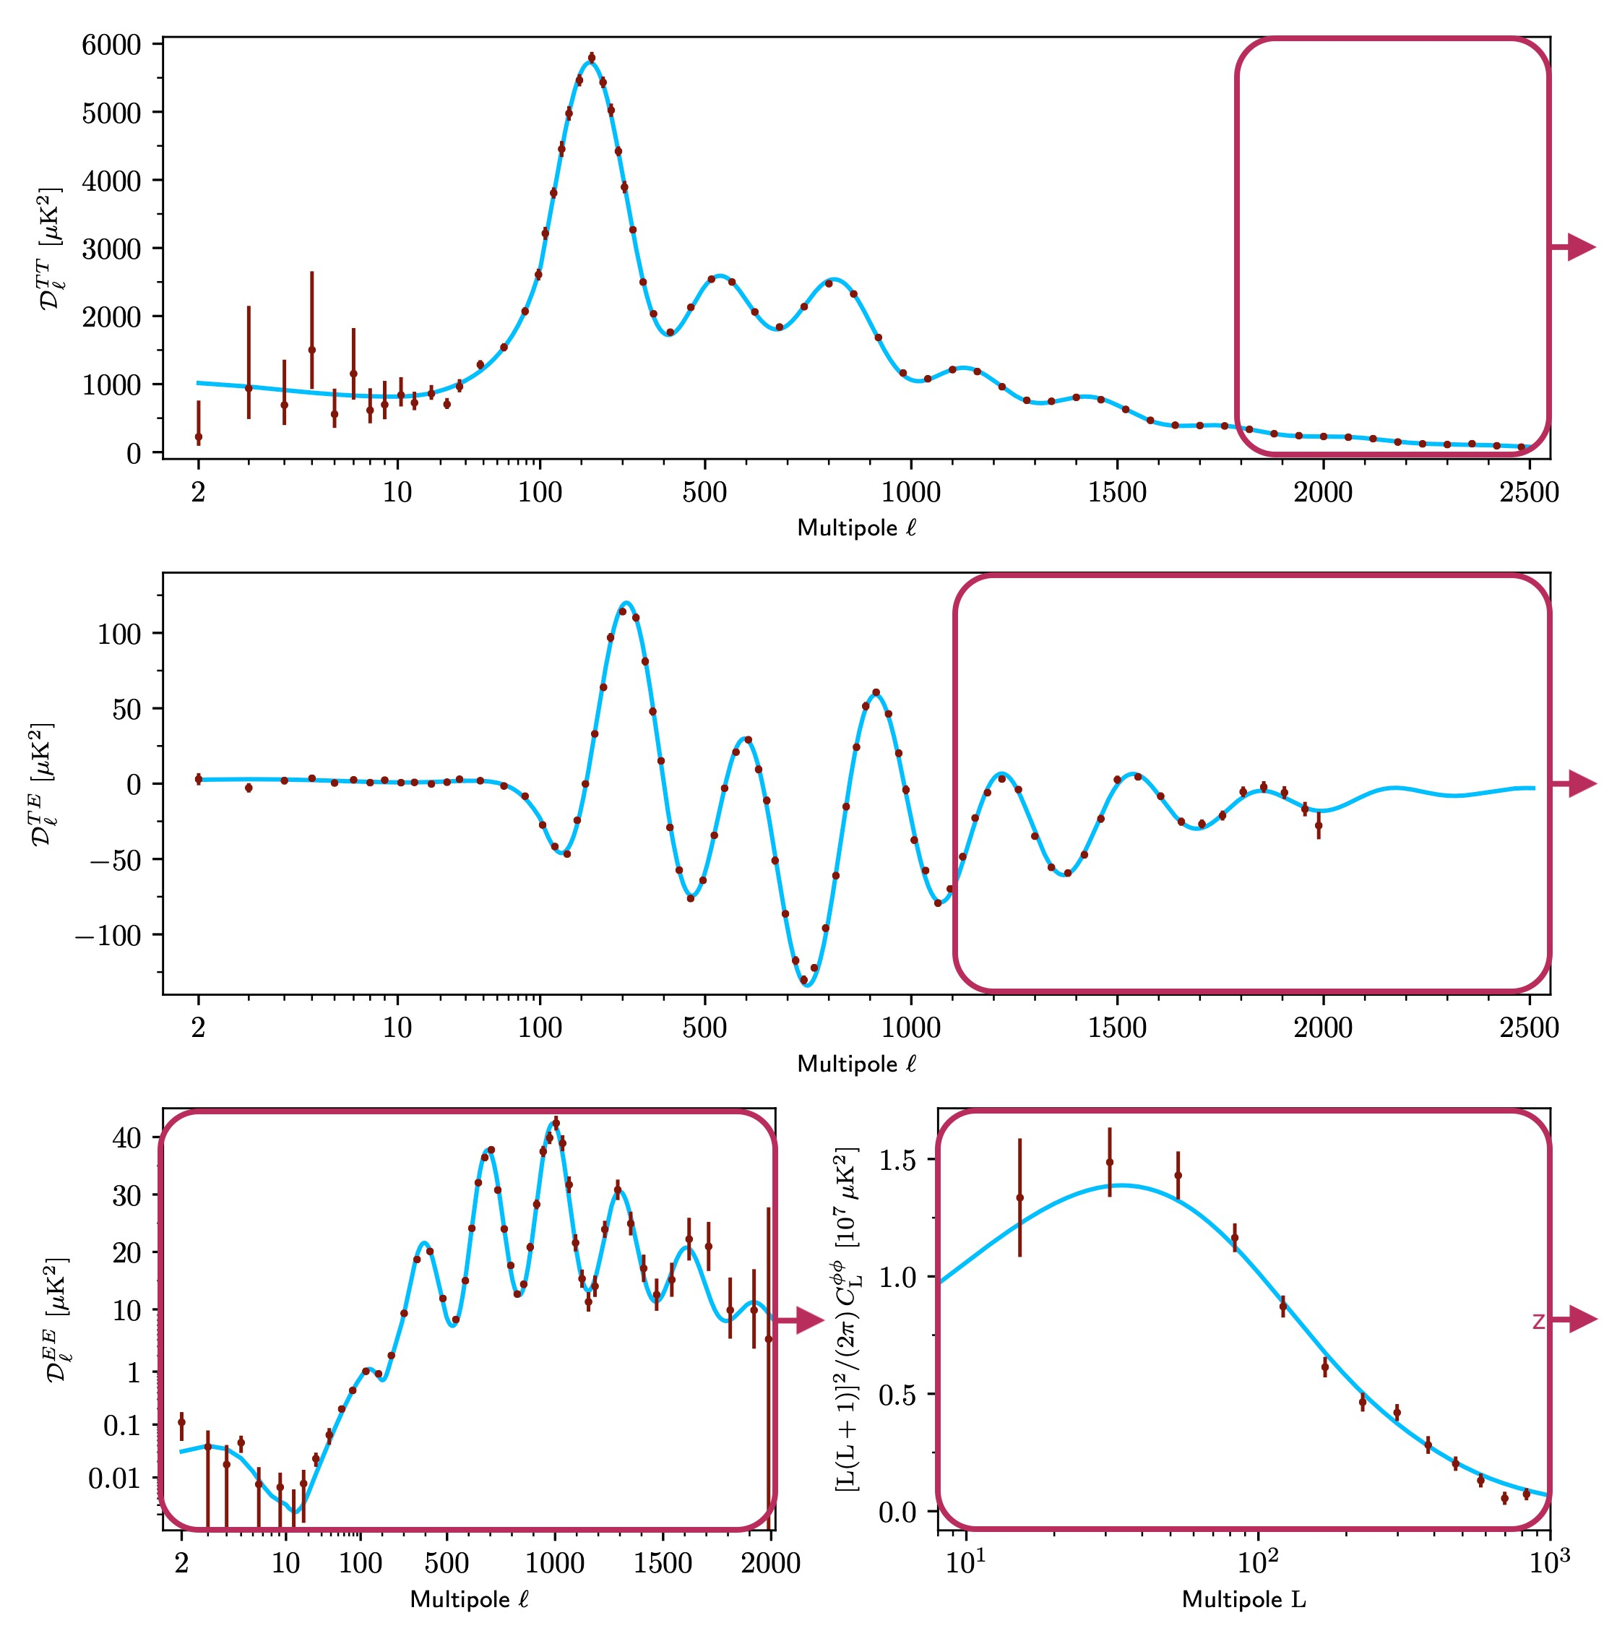





The CMB Beyond Planck
Planck is noise-variance-limited beyond:
in TT, in TE;
everywhere in EE and lensing ( ).
8

Slide 12


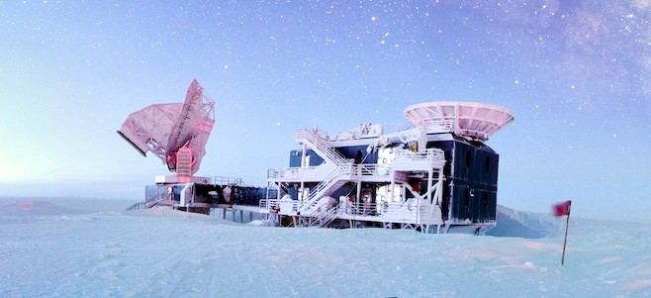
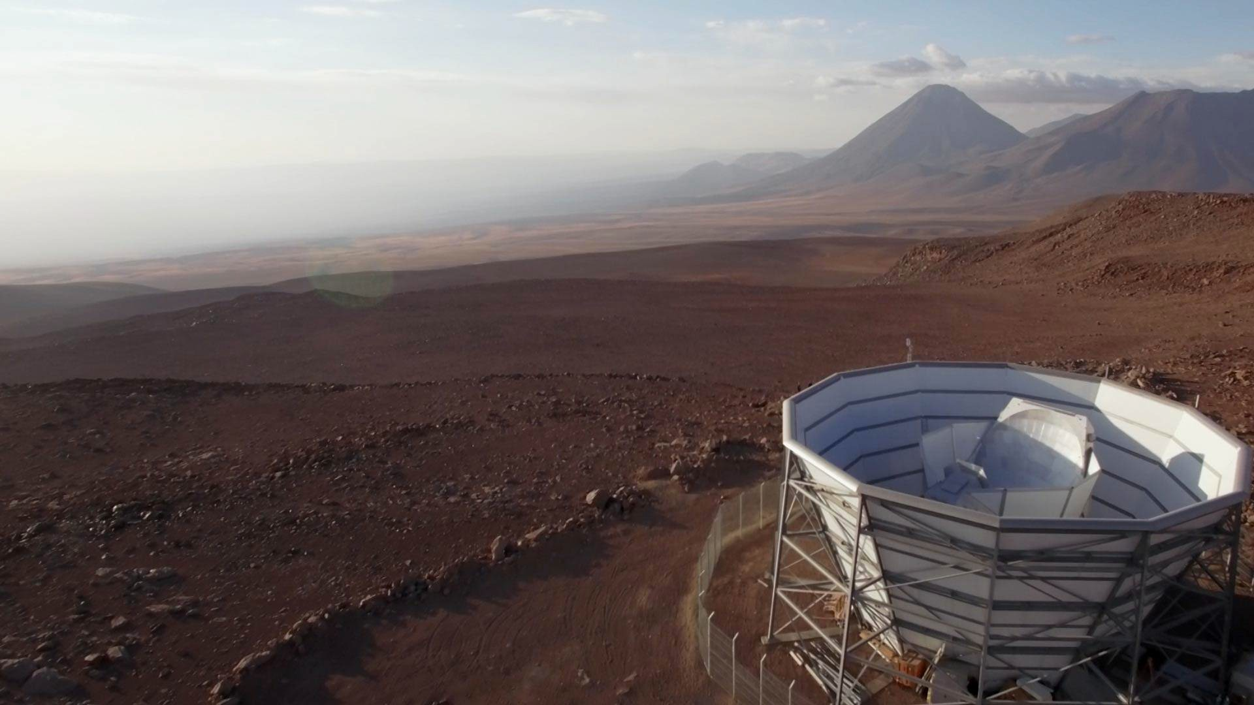
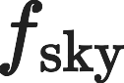
The CMB Beyond Planck
Planck is noise-variance-limited beyond:
in TT, in TE;
everywhere in EE and lensing ( ).
SPT BICEP/Keck
ACT
Aman Chokshi
Debra Kellner
 | (effective) | resolution (arcmin) | sensitivity ( K-arcmin)
Planck | 0.67 | 5.0 | 27
ACT | 0.23 | 1.0 | 12
SPT | 0.035 | 1.0 | 1.9
B/K | 0.014 | 21 | 3
*crude summary of CMB experiments
8.1

Slide 13
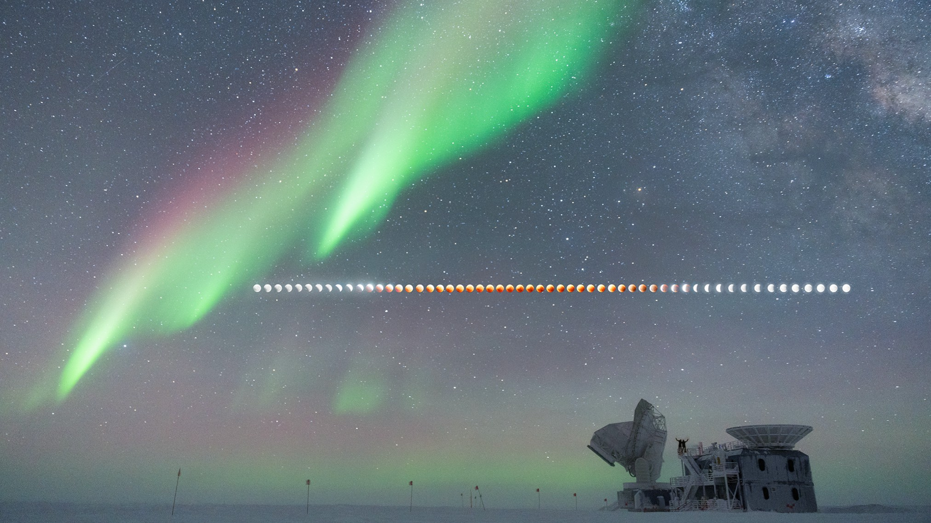
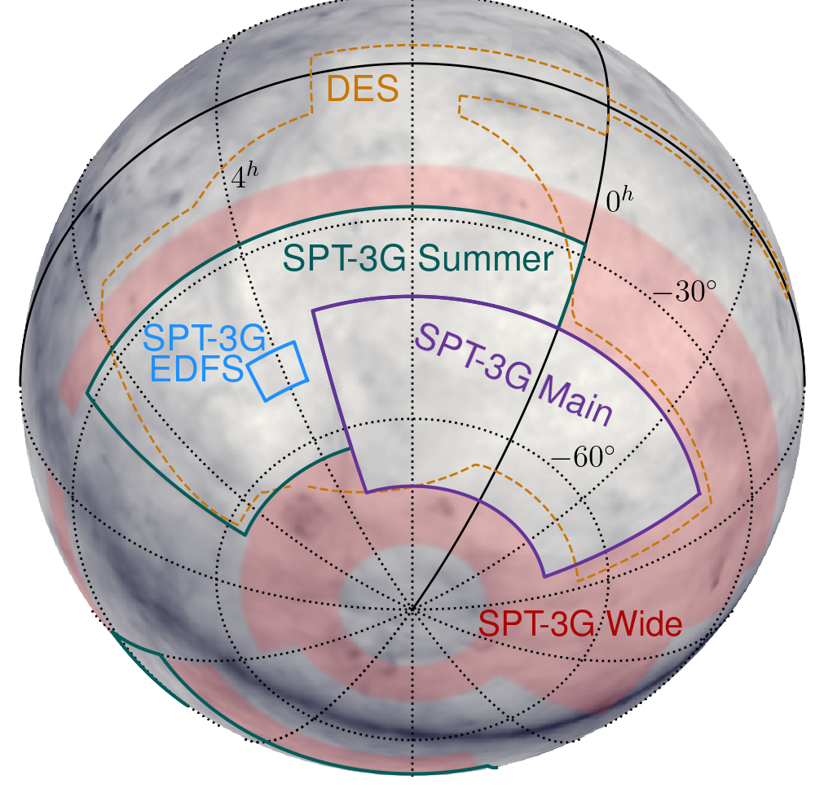
The South Pole Telescope
3 bands: 95,
resolution: 1.6,
150,
1.2,
220 GHz
1.0 arcmin
SPT-SZ (2007) | SPTpol (2012) | SPT-3G (2017)
~1000 detectors | ~1500 detectors | ~16,000 detectors

Slide 14
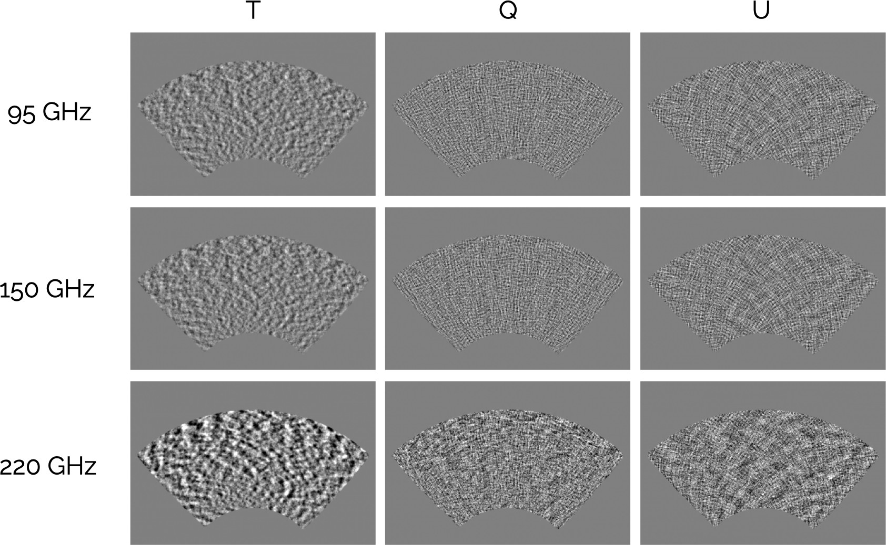
2019+2020 Analyses
Maps used by three independent pipelines:

Slide 15
2019+2020 Analyses
Maps used by three independent pipelines:
1. Traditional TT/TE/EE power spectrum

Slide 16
2019+2020 Analyses
Maps used by three independent pipelines:
Traditional TT/TE/EE power spectrum
Traditional quadratic estimator (QE) lensing

Slide 17
2019+2020 Analyses
Maps used by three independent pipelines:
Traditional TT/TE/EE power spectrum
Traditional quadratic estimator (QE) lensing
MUSE: Bayesian joint inference of cosmology, systematics, and pixels

Slide 18
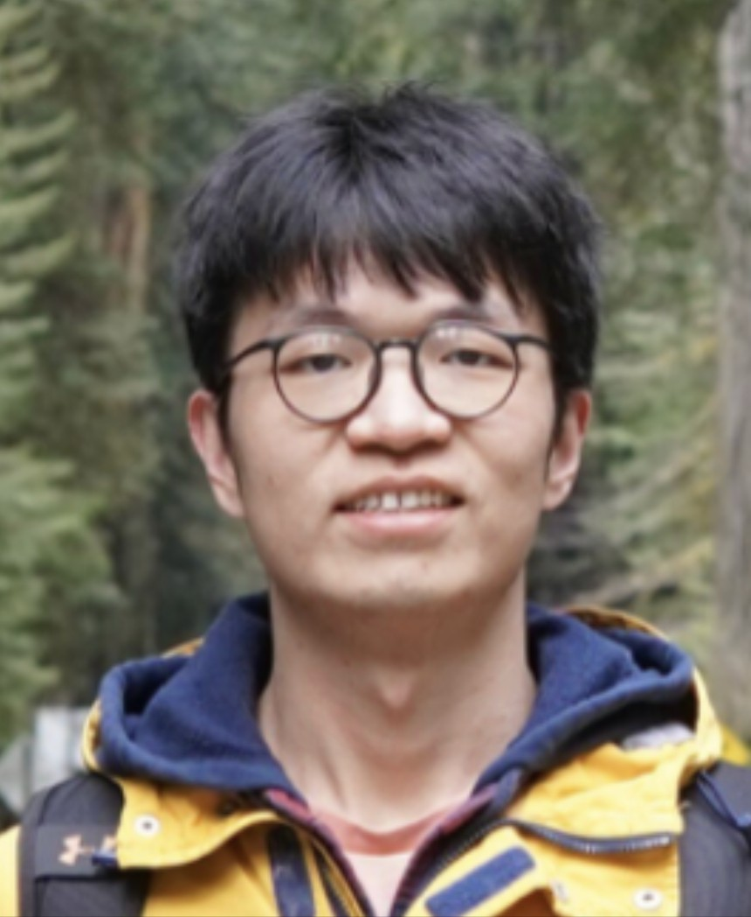
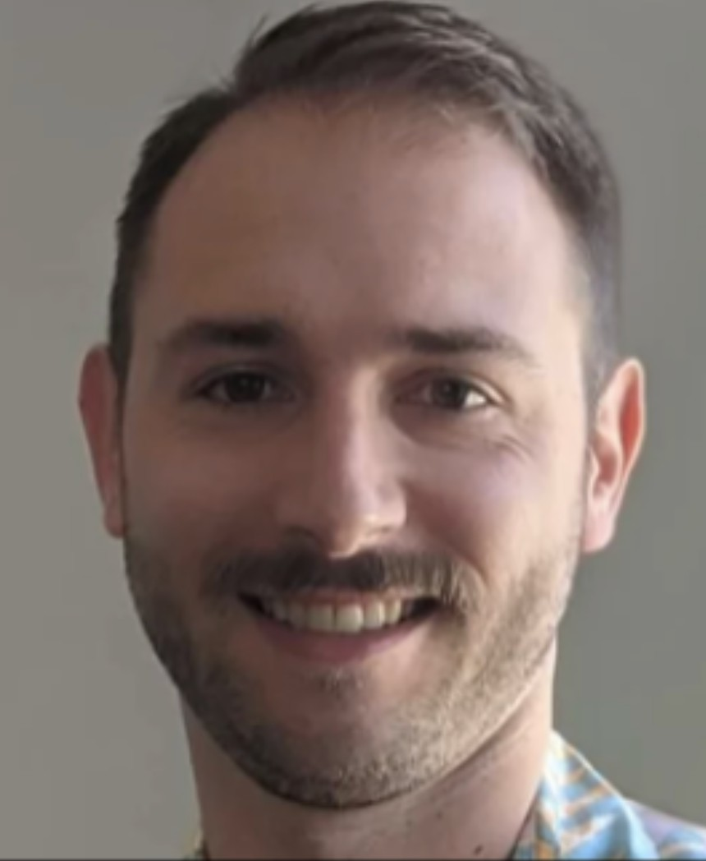
MUSE
(Marginal Unbiased Score Expansion)
Accepted as of last week! arxiv:2411.06000
Fei Ge
Marius Millea
11

Slide 19
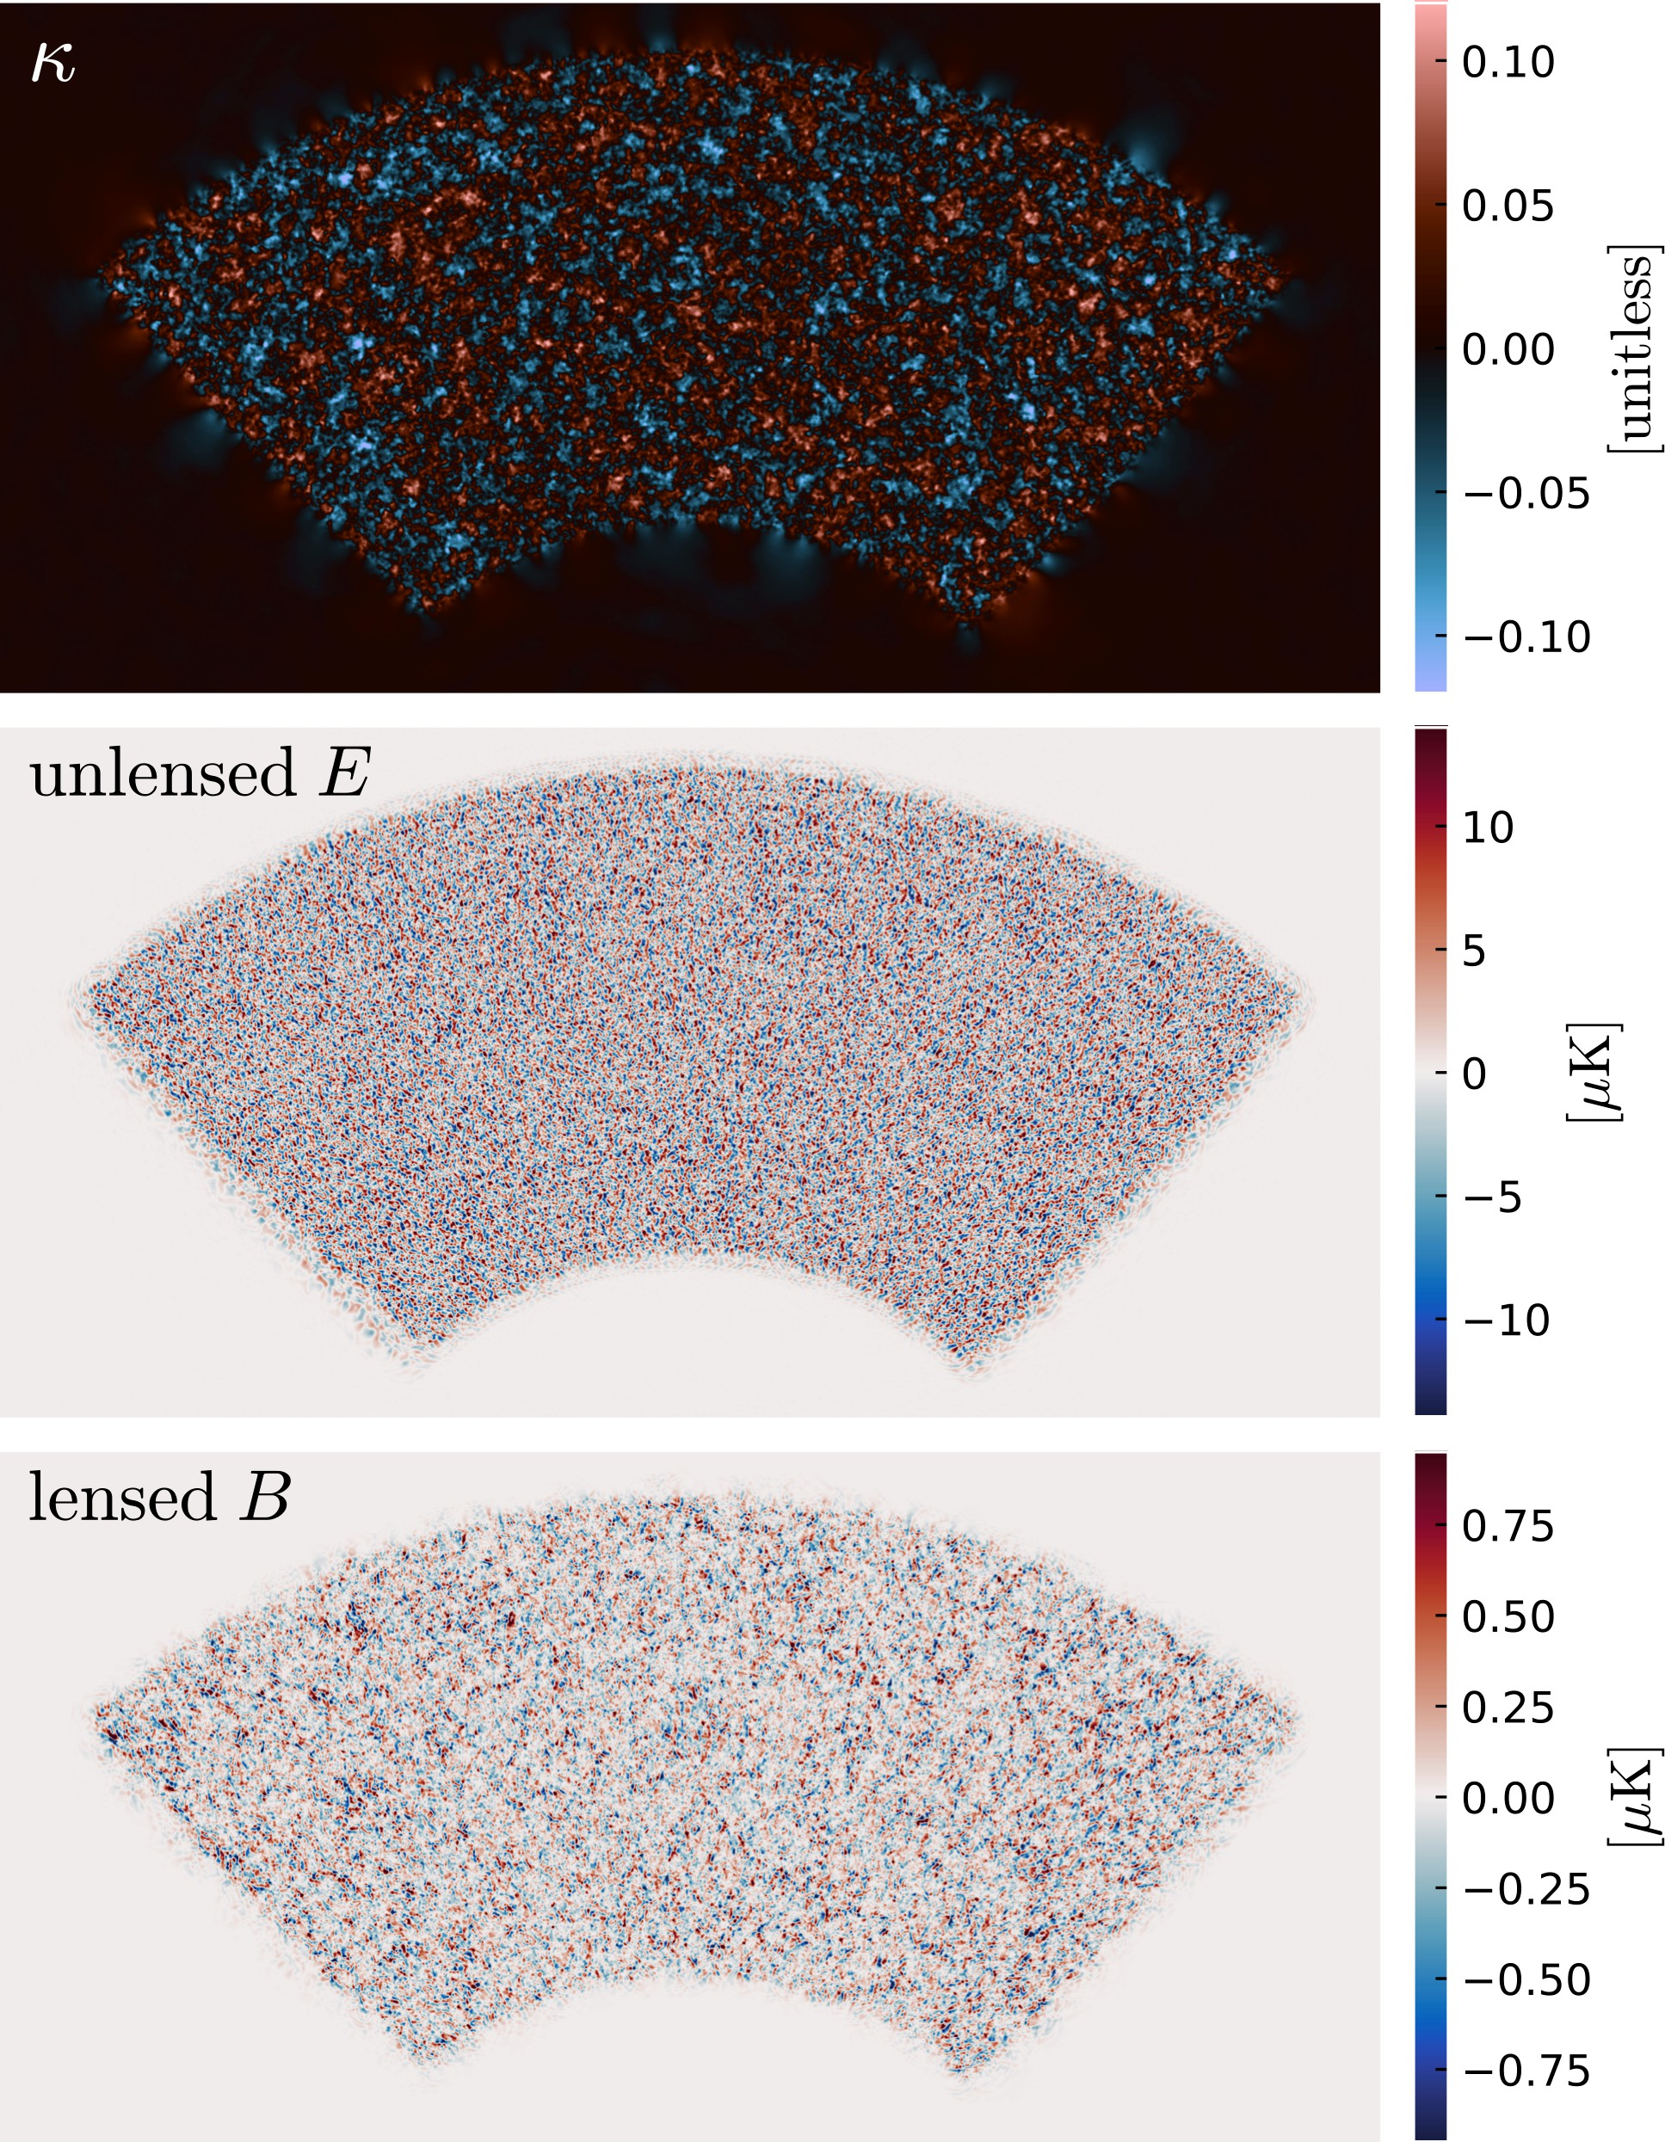


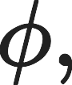
MUSE
(Marginal Unbiased Score Expansion)
Accepted as of last week! arxiv:2411.06000
Marginalize over CMB and lensing maps/pixels to determine parameters :

Slide 20
MUSE
(Marginal Unbiased Score Expansion)
Accepted as of last week! arxiv:2411.06000
Marginalize over CMB and lensing maps/pixels to determine parameters :
Algorithm similar to simulation-based inference (SBI) with semi-analytic compression statistic.

Slide 21
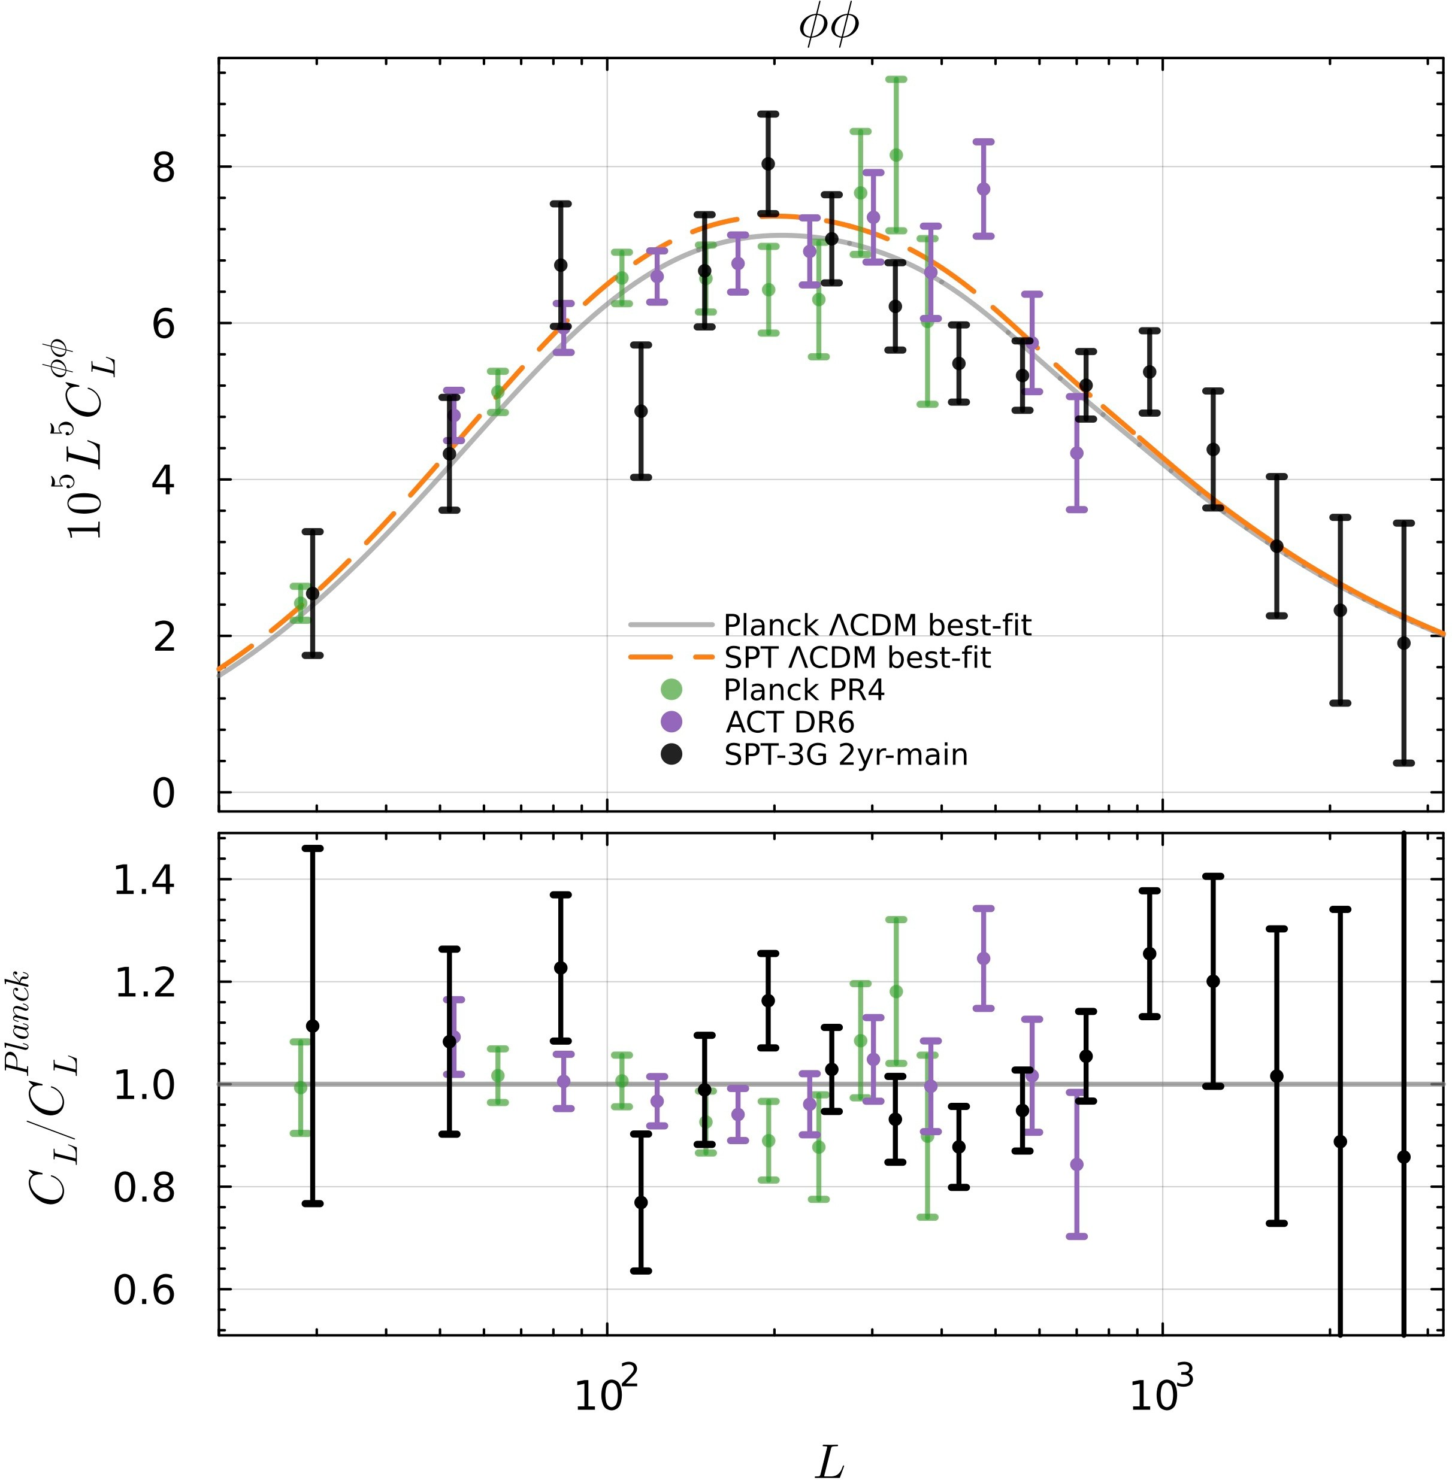

MUSE Results: Bandpowers
EE & bandpowers in agreement with CDM and Planck.
12

Slide 22
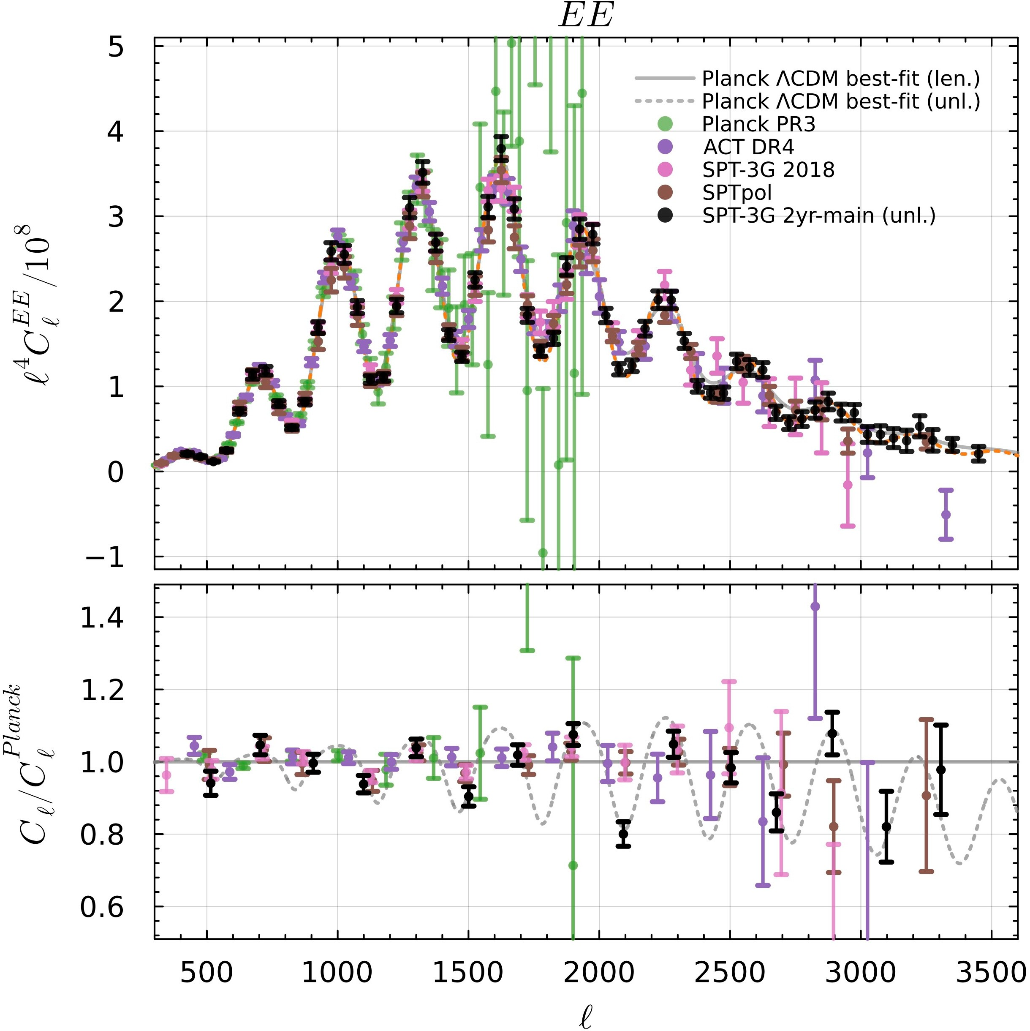
MUSE Results: Bandpowers
EE & bandpowers in agreement with CDM and Planck.

Slide 23
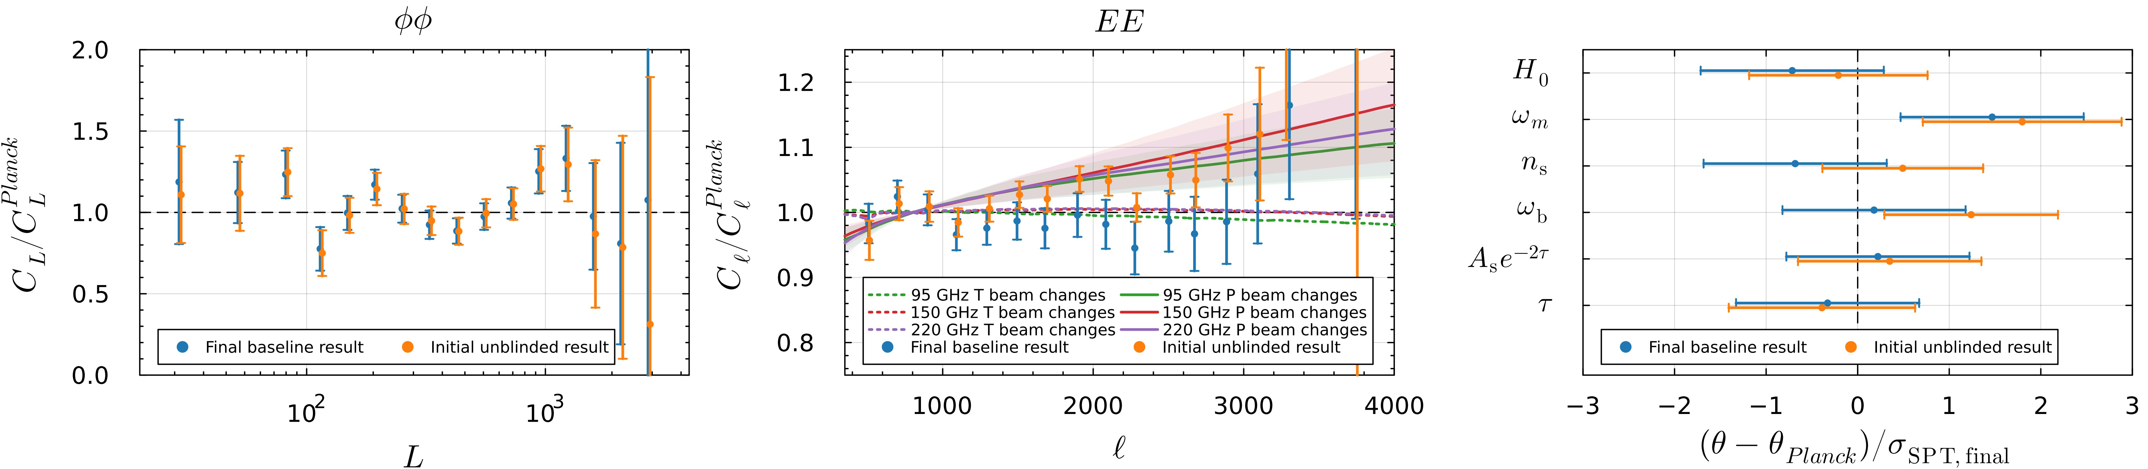
MUSE Results: Bandpowers
EE & bandpowers in agreement with CDM and Planck.
Blinded analysis
with post-unblinding beam change:

Slide 24

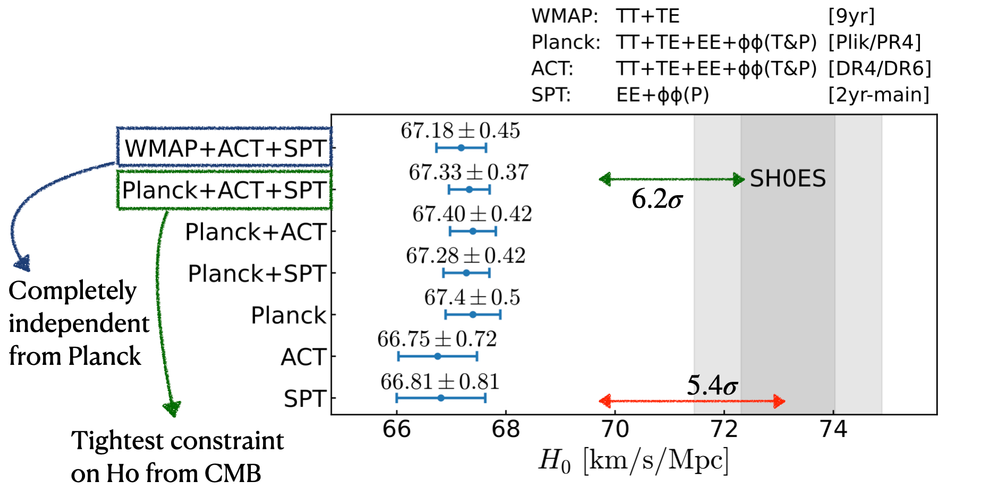
MUSE Results:

Slide 25
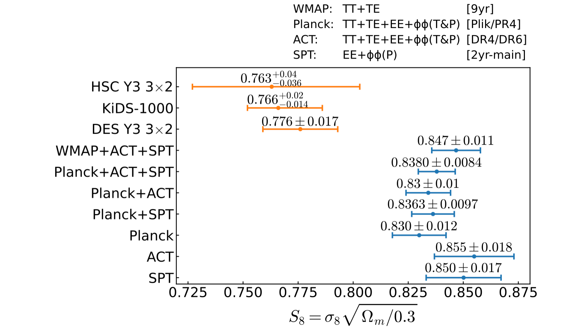


MUSE Results:

Slide 26
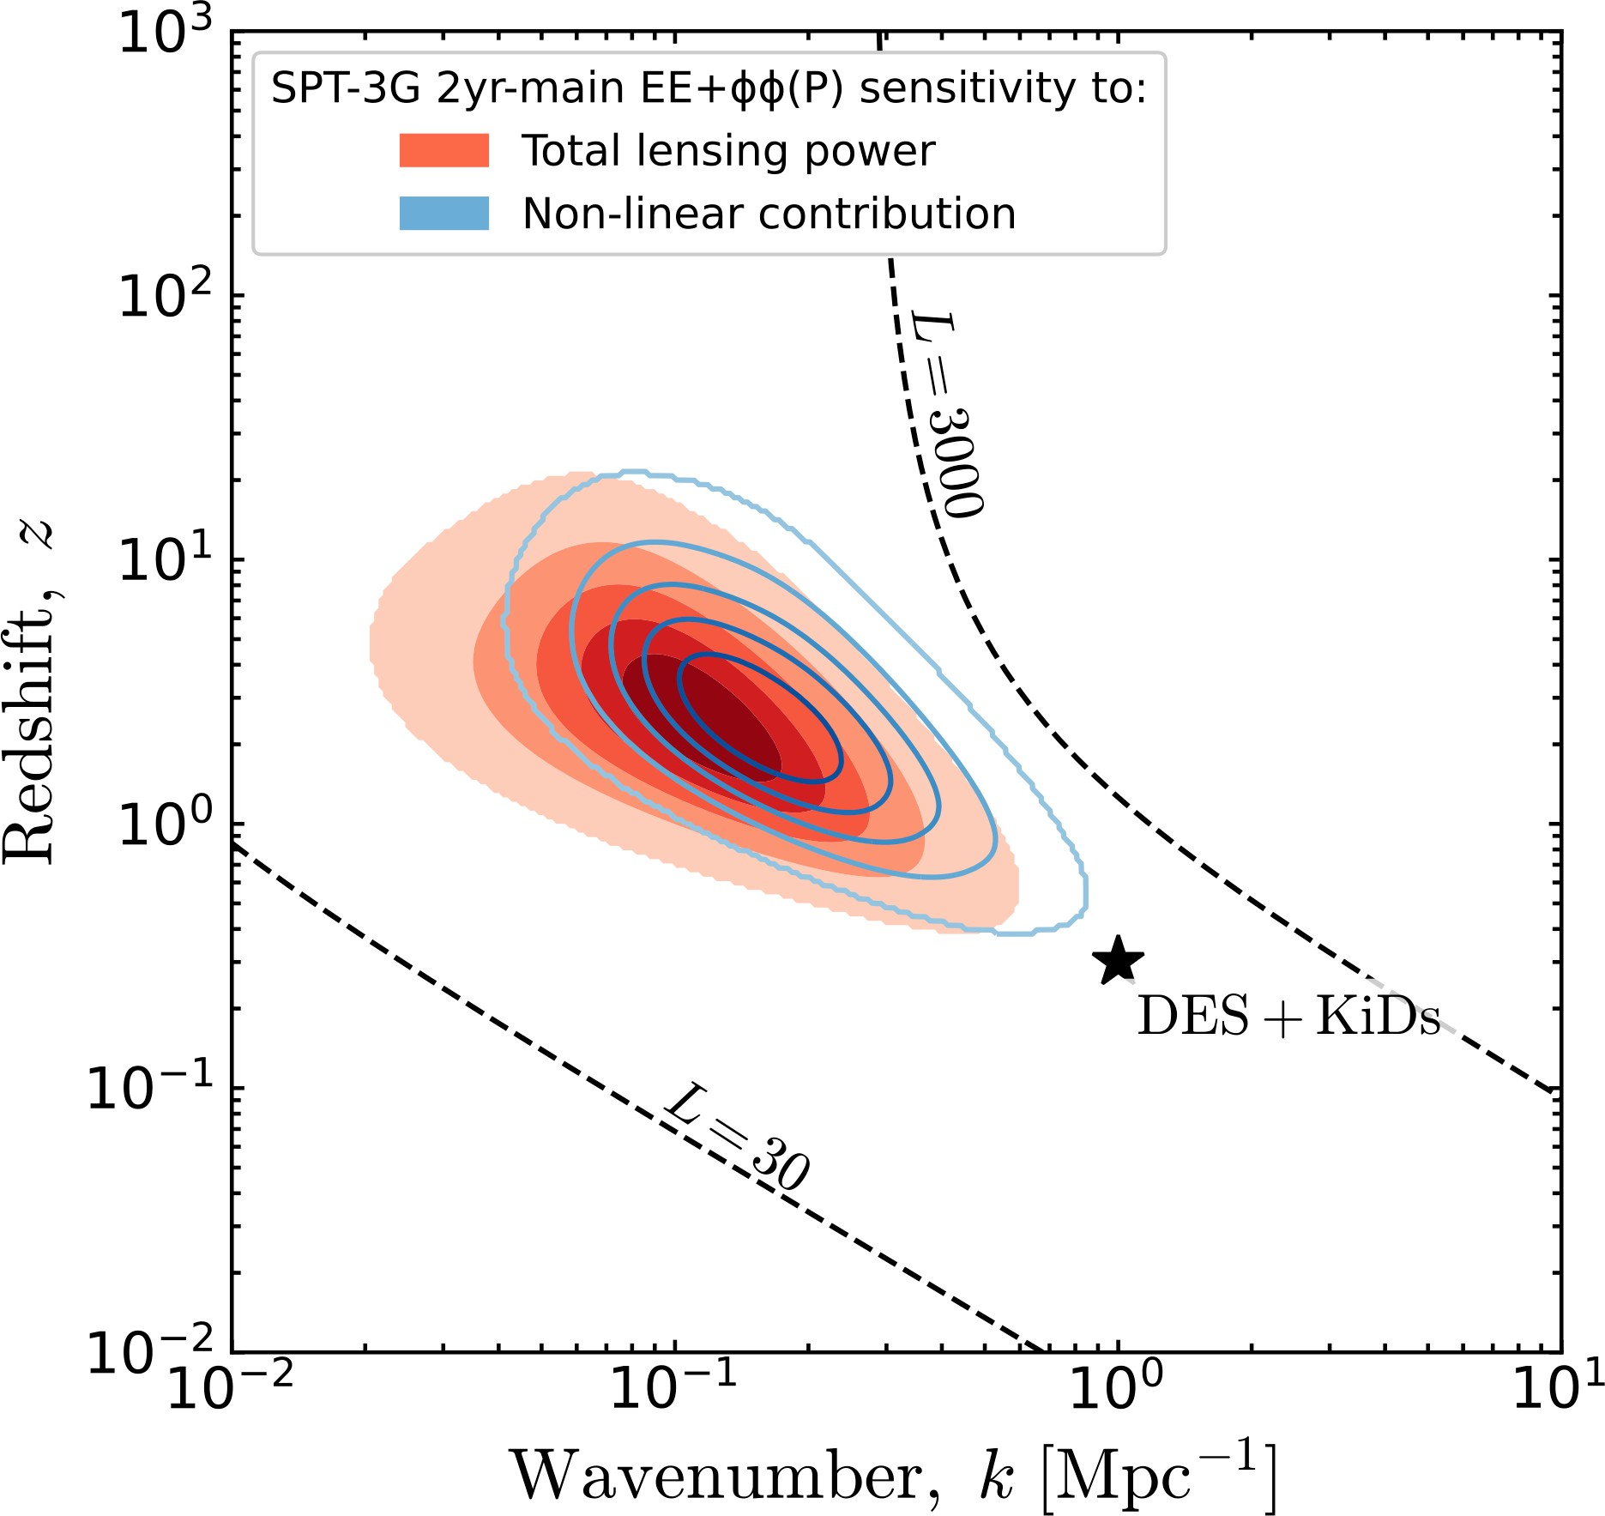

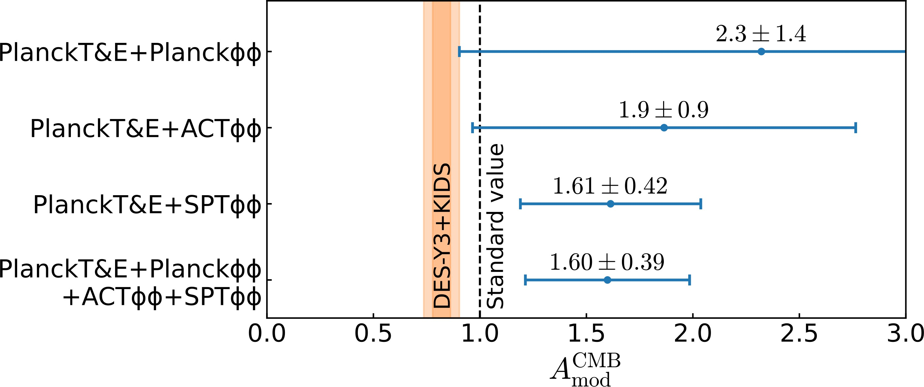

MUSE Insights on Structure Growth
to scale the non-linear matter power spectrum:
Planck T&E + SPT gives first detection of non-linear structure with CMB lensing!

Slide 27
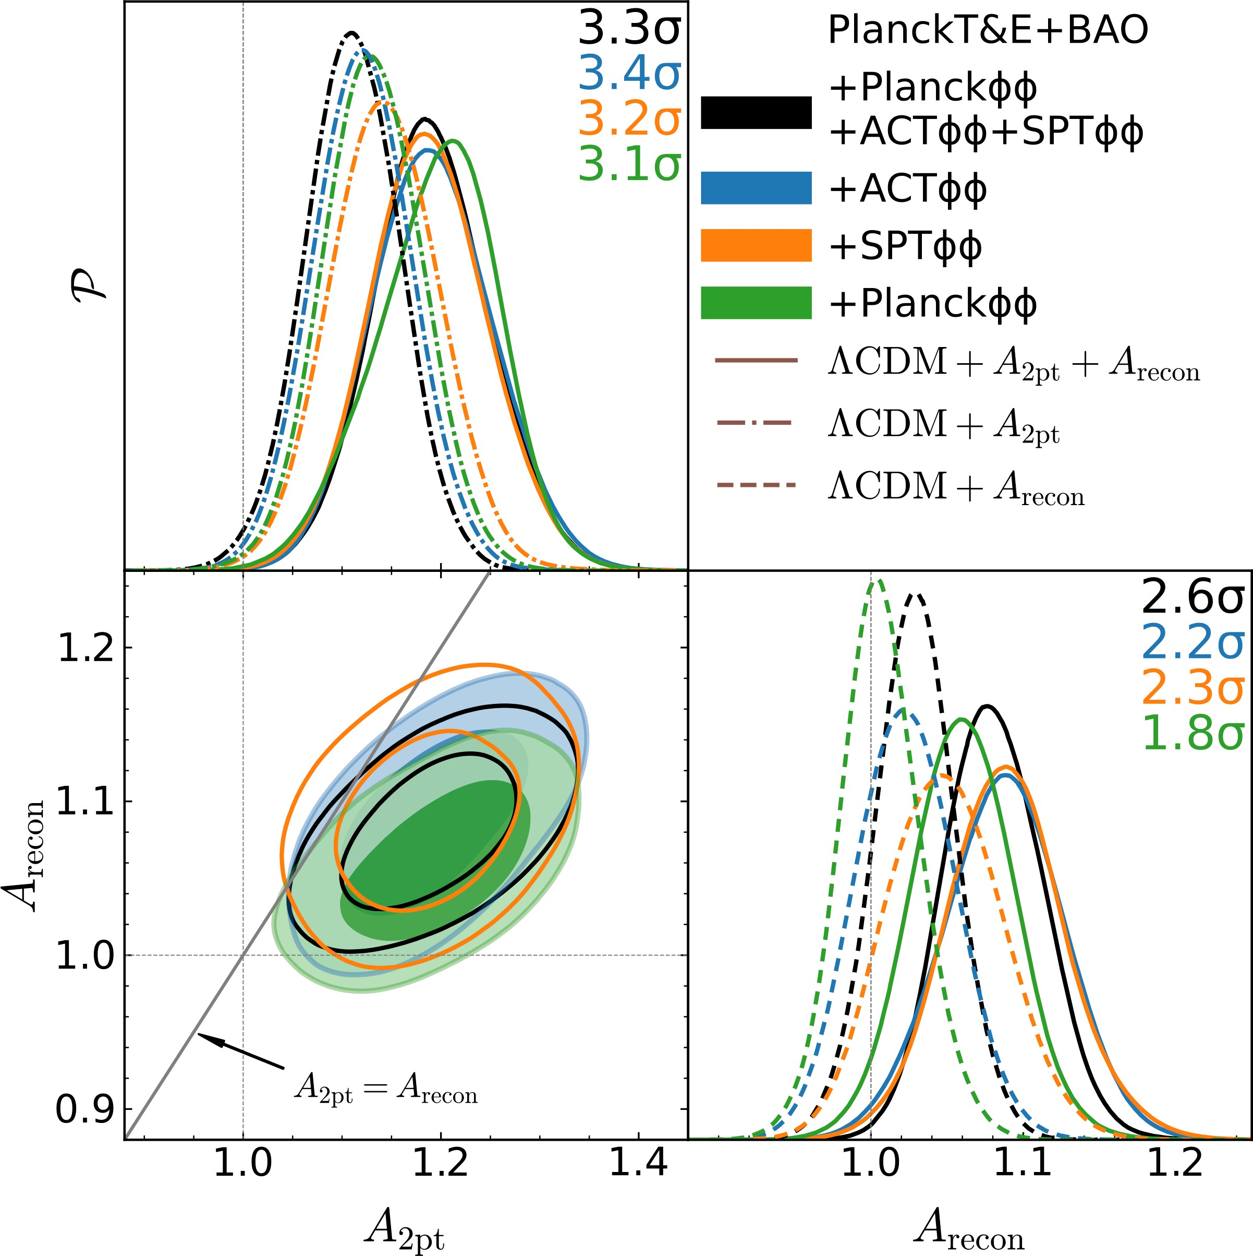





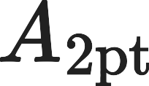




MUSE Insights on Neutrino Mass
Decreasing neutrino mass enhances structure (measured by ).
CMB prefers more lensing power than
predicted by
low
CDM given BAO.
when allowed to vary.
: scales lensing power used to predict lensed CMB power spectra
: scales lensing power used to predict lensed CMB power spectra
: if

Slide 28
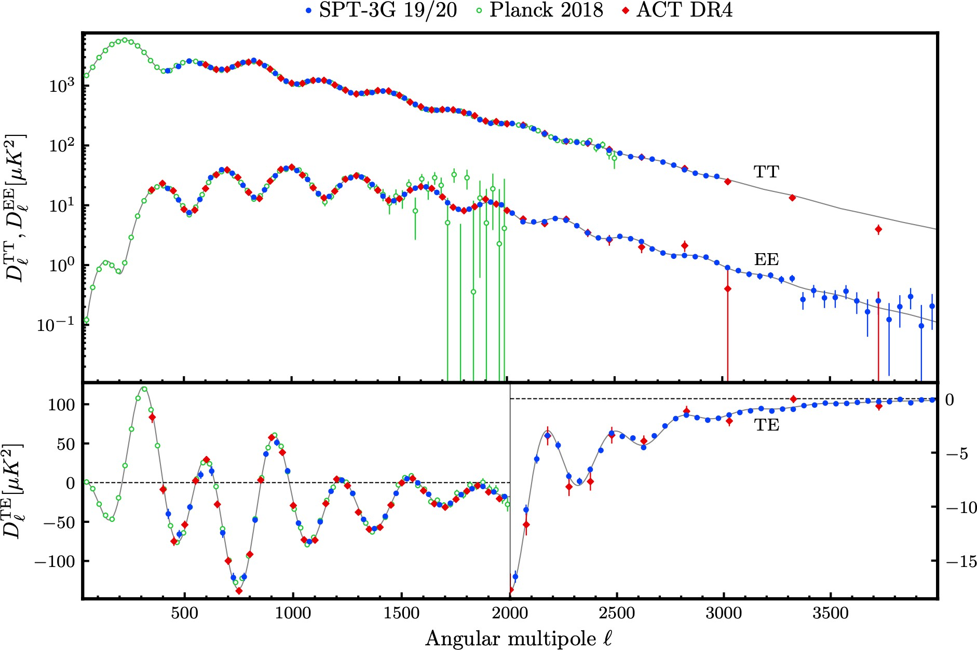
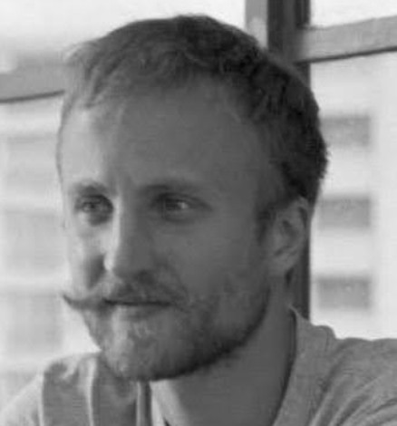
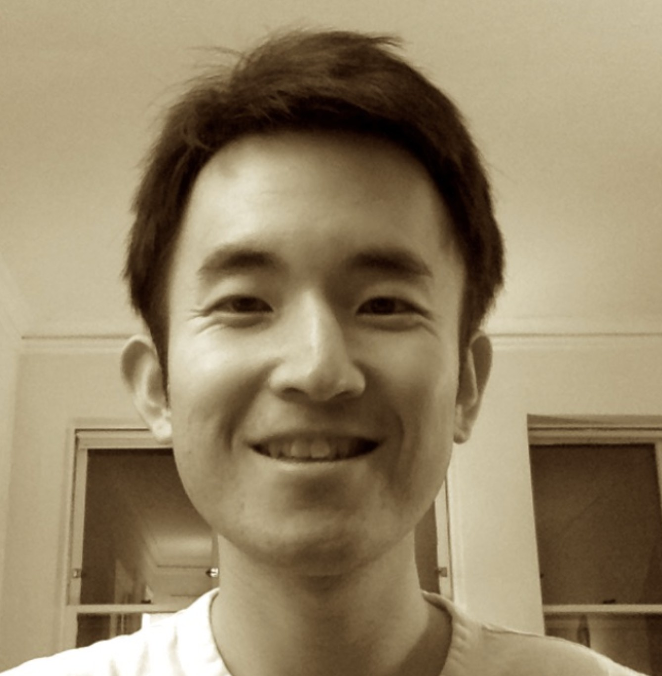
Upcoming 19+20 Results: TT/TE/EE
Etienne Camphuis
Wei Quan

Slide 29
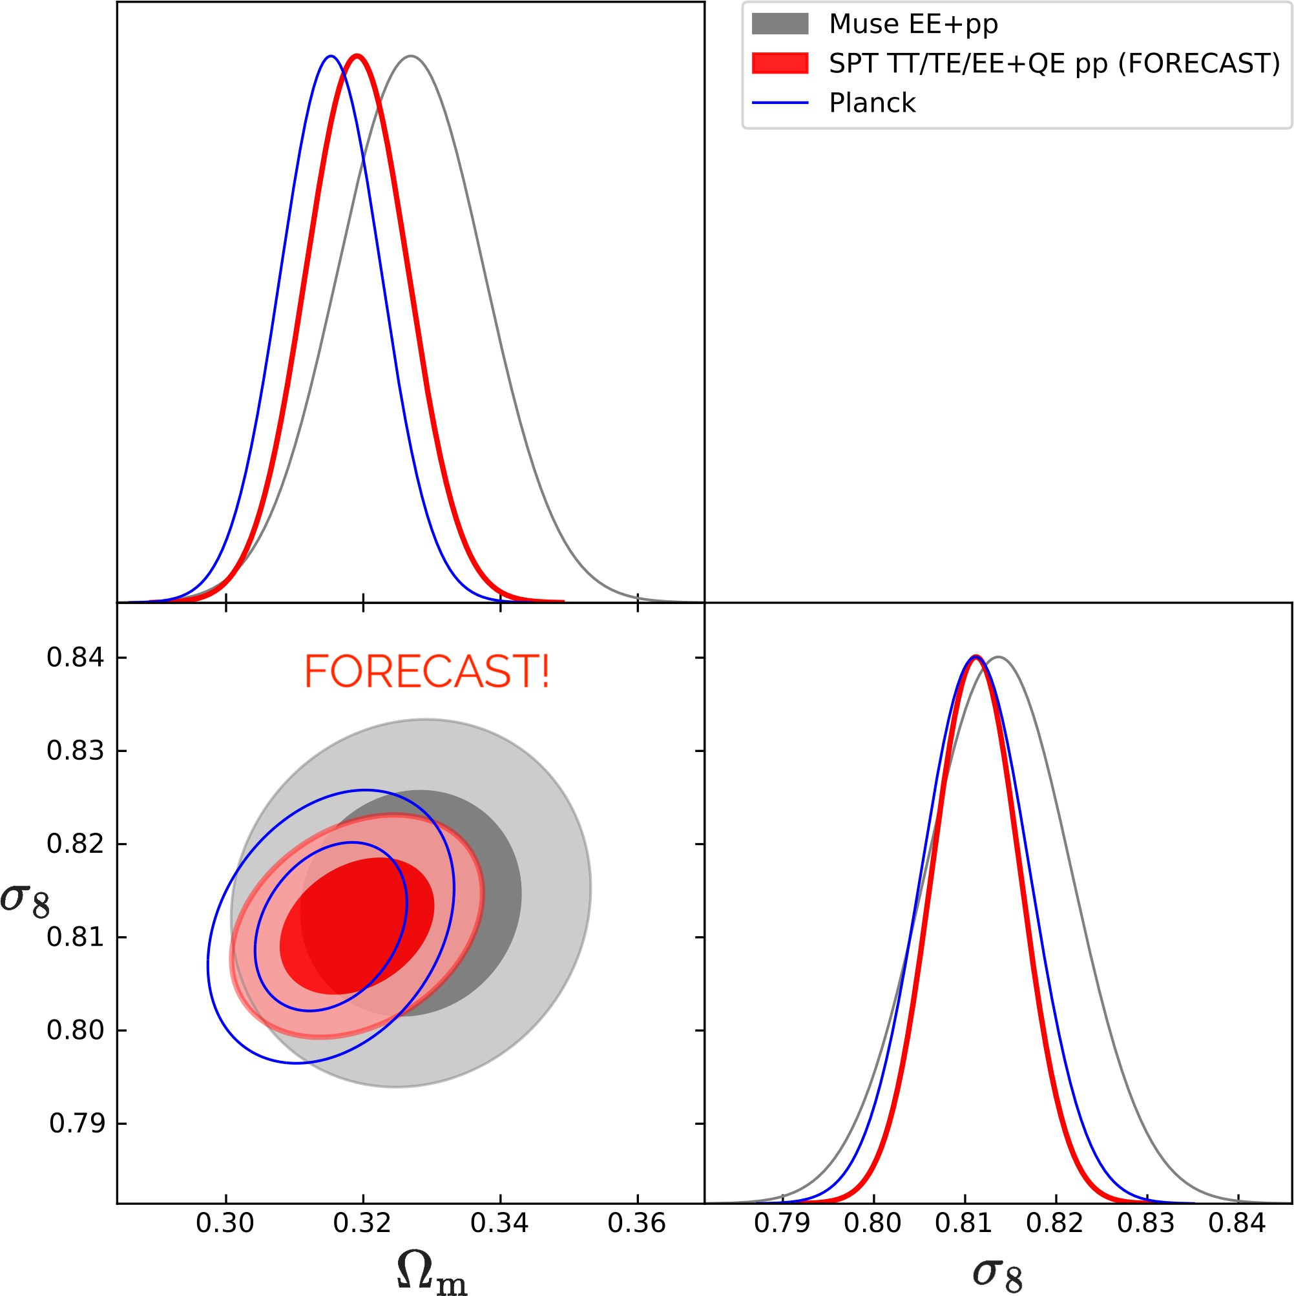
Upcoming Results: EE/TE/EE/
Targeting publication this summer.
As a taste, mock SPT-3G TT/EE/TE + polarization-only lensing compared to MUSE and Planck.
Joint constraints on CDM parameters will be comparable to Planck!

Slide 30
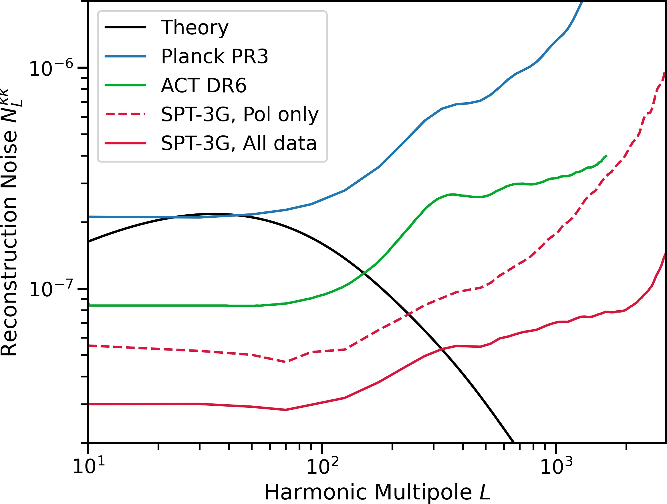
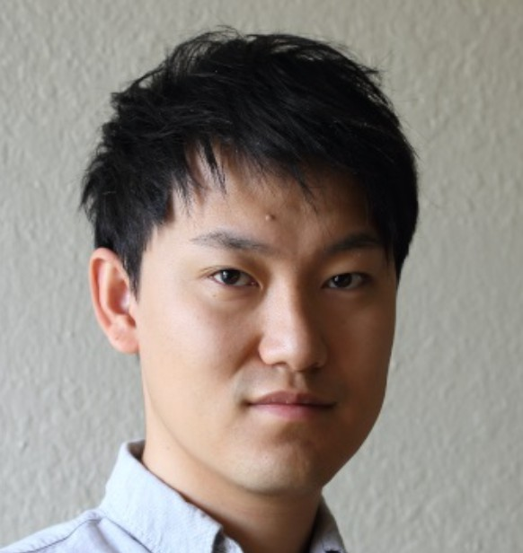
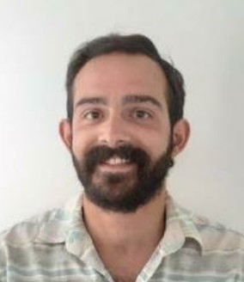
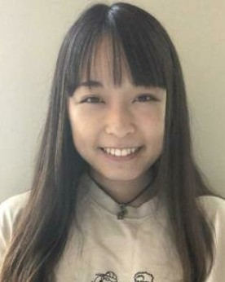
Upcoming Results: 19+20 QE Lensing
Myself
Yuuki Omori
Federico Bianchini
Yuka Nakato

Slide 31
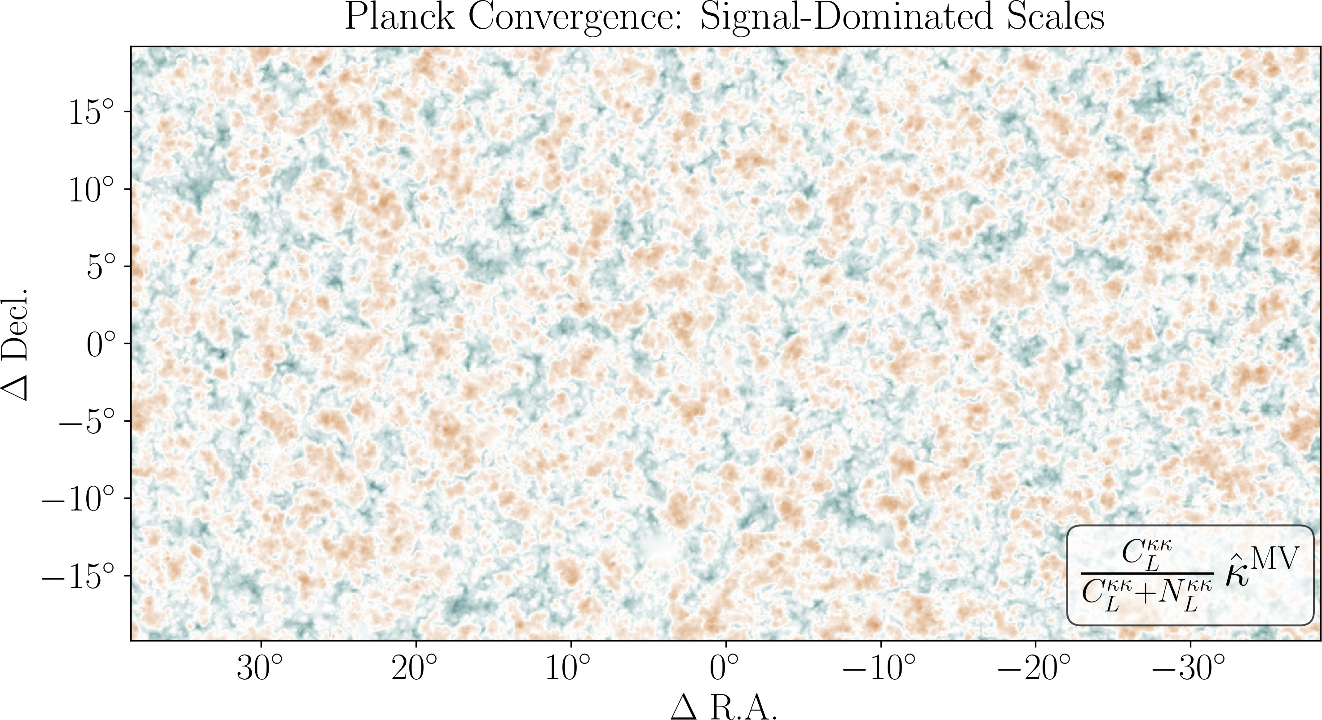
Upcoming Results: 19+20 QE Lensing

Slide 32
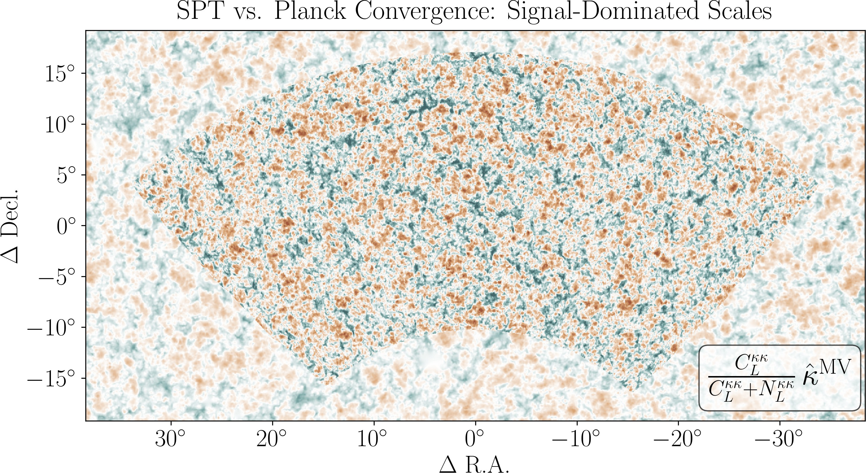
Upcoming Results: 19+20 QE Lensing
20.1

Slide 33
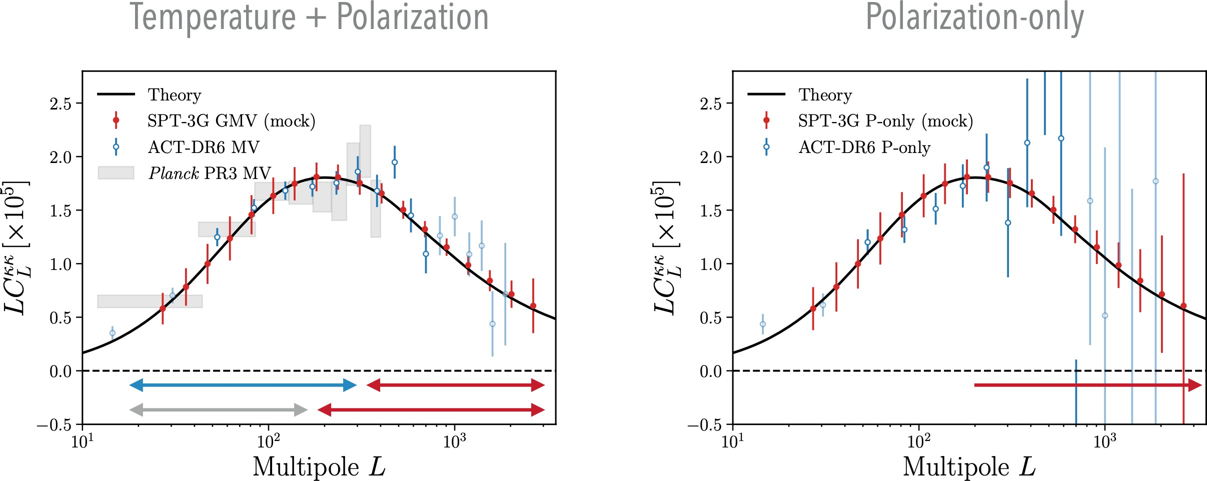

Upcoming Results: 19+20 QE Lensing
Federico Bianchini
1.3% measurement of
from SPT-3G lensing + DESI BAO alone!

Slide 34
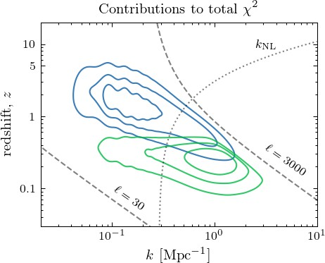
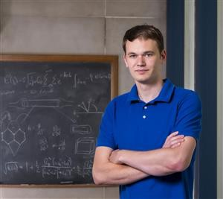
Upcoming Results: Cross-correlations
SPT-3G lensing: large scales, high (mostly linear)
SPT-3G lensing
Cosmic shear: smaller scales, low (mostly non-linear)
DES Y3 bin 4
Aaron Ouellette

Slide 35
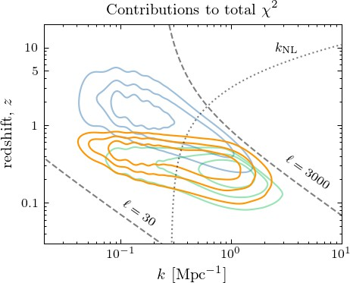
Upcoming Results: Cross-correlations
SPT-3G lensing: large scales, high (mostly linear)
SPT-3G lensing
Cosmic shear: smaller scales, low (mostly non-linear)
Cross-correlation bridges the gap
DES Y3 bin 4
Aaron Ouellette
22.1

Slide 36


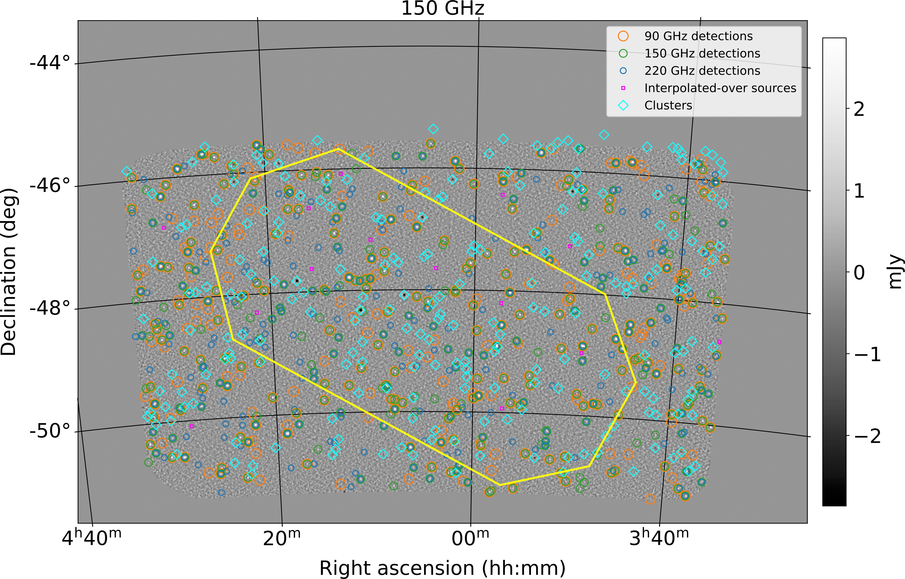

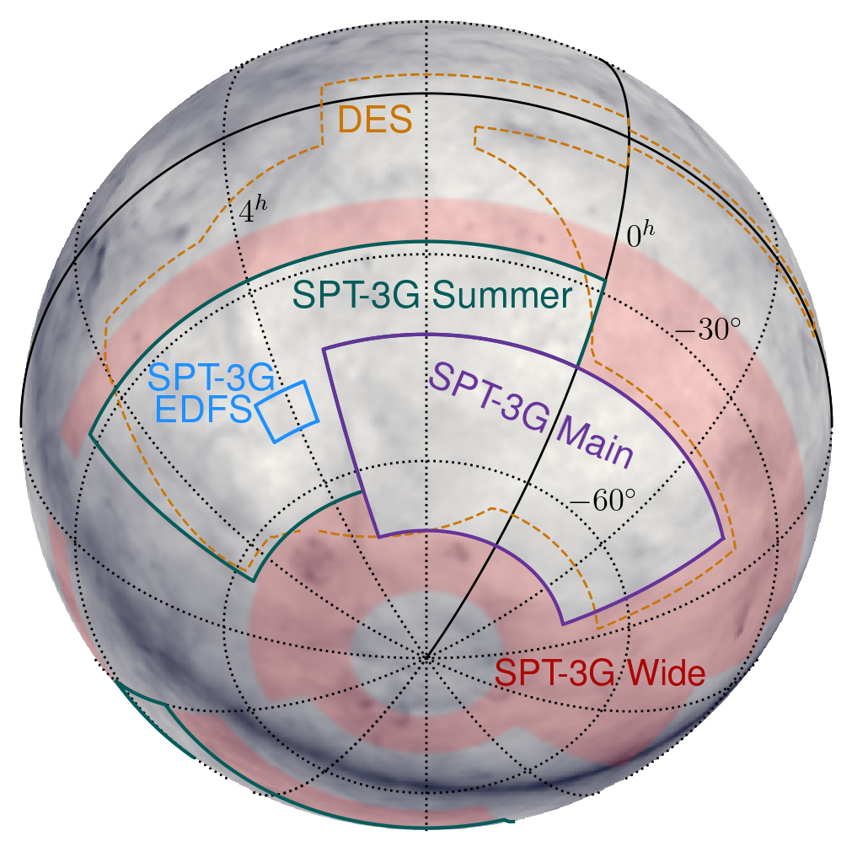
SPT-3G and Euclid
SPT has observed Euclid Deep Field South (EDFS) and is planning a release of: temperature maps and general products
emissive source catalogs cluster catalogs
~alongside the Euclid Q1 release.

Slide 37
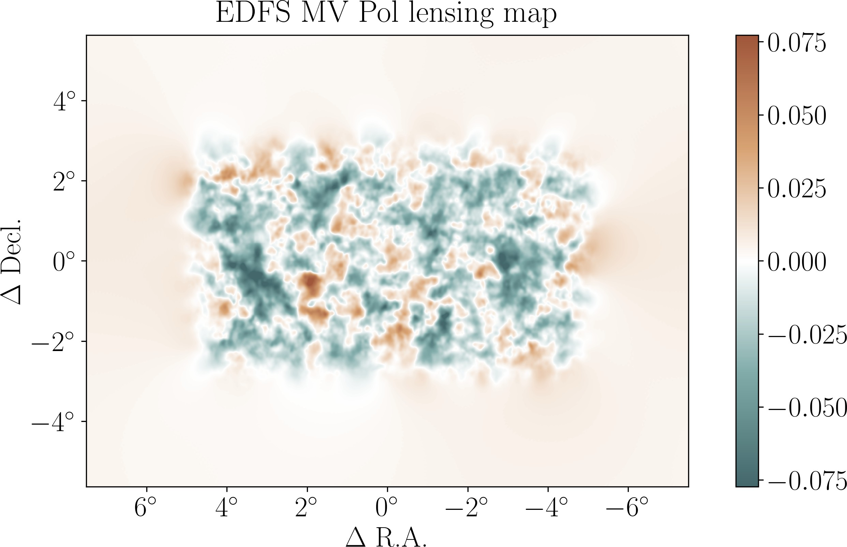
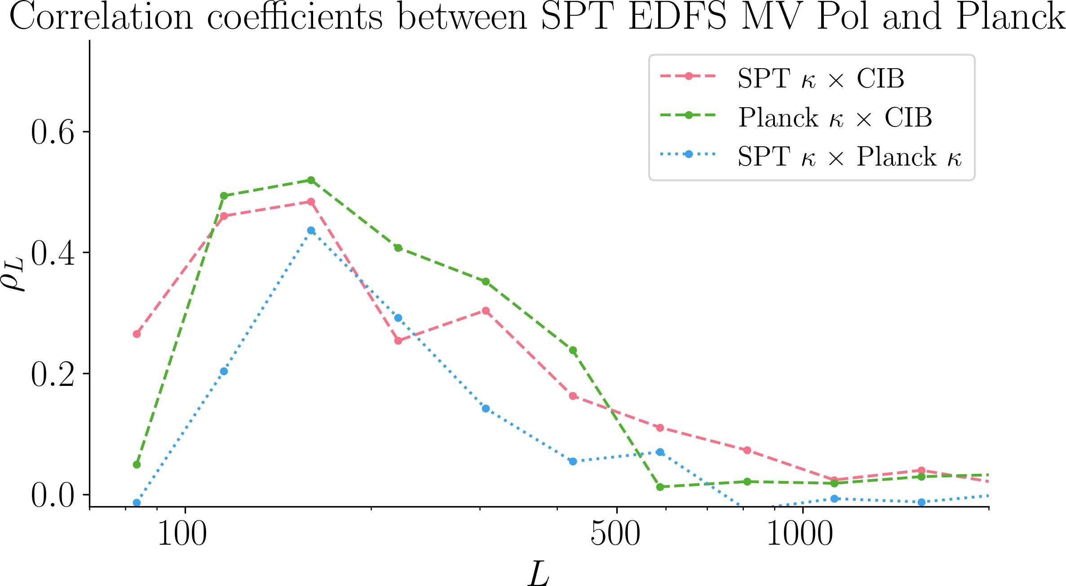
SPT-3G and Euclid
I am working on lensing maps to be cross-correlated with Euclid Q1 data:
Will be useful pathfinding for Euclid DR1+ cross CMB analyses.

Slide 38



Summary & Looking Forward
The CMB still has a lot to tell us about the Universe: small scales, polarization, lensing
SPT-3G Main 2019+2020:
MUSE polarization-only results are consistent with Planck CDM
sharpens questions on neutrino mass/lensing amplitude/structure growth coming temperature+polarization constraints will be comparable to Planck!
ACT DR6 results next Tuesday! (March 18th 4 pm CET)

Slide 39
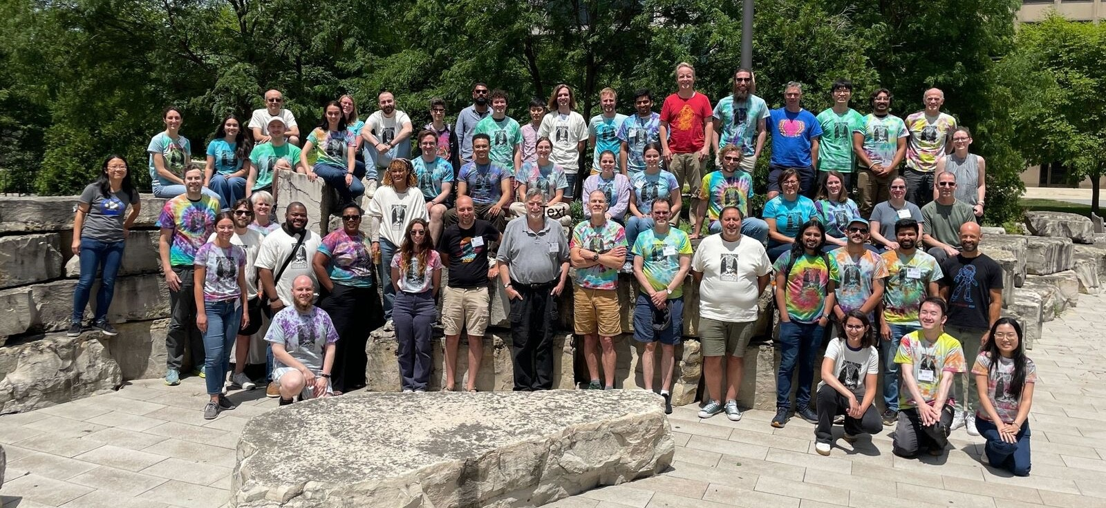
Thank You!

